Slide 1




Slide 2

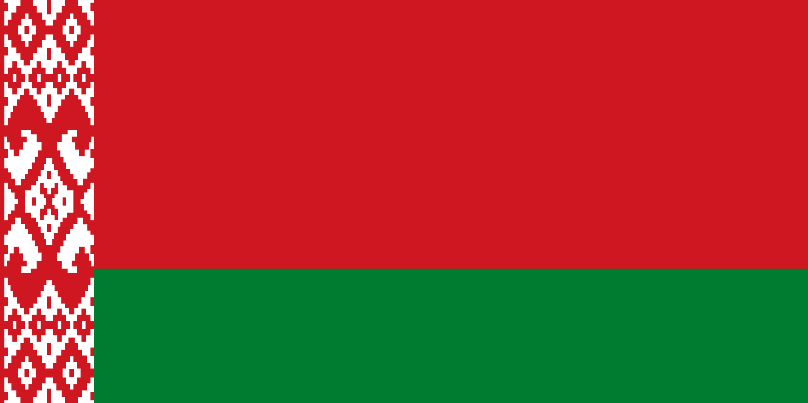
PRAYING FOR
BELARUS

Slide 3
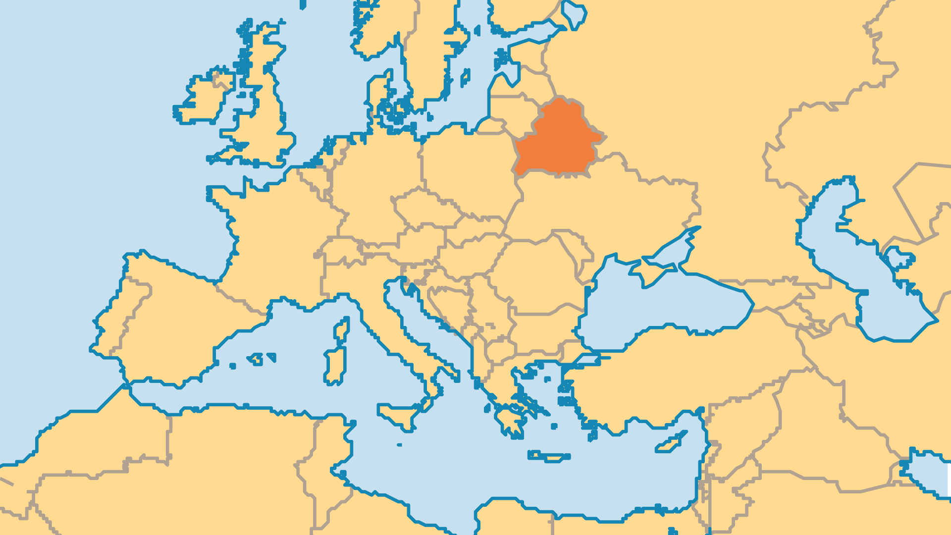
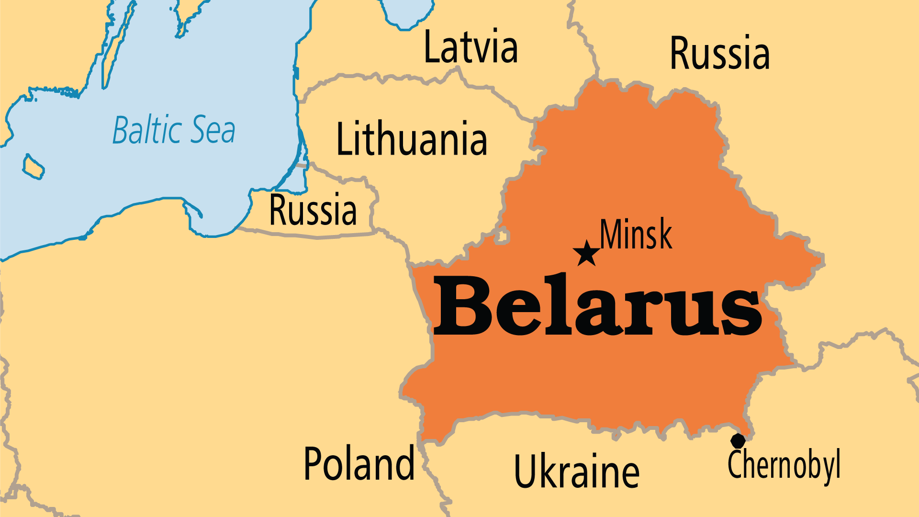
KEY STATS
Capital: | Minsk
Population: | 8,997,603
% Urban: | 81.5 %
Pop Under 15 Yrs: | 17 %
Official Language: | Belarusian and Russian
Literacy Rate: | 100 %
% Christian: | 70.5 %
% Evangelical: | 1.3 %
Least Reached People Groups: | 6
% Unevangelized: | 1 %

Slide 4

FOR PRAYER
Belarus declared itself sovereign from the USSR in 1990, but it continues to operate more like a Communist-era authoritarian regime - President Lukashenko has kept his position since 1994! A sham election in 2025 brought the President a seventh term in office. Belarus has suffered due to an ineffective centralized economy. The support and influence of Russia runs very deep and is likely the only thing keeping Lukashenko in power. Pray that corruption might be exposed and that justice might prevail. Pray for hope and a brighter future for the people of Belarus.
Want to know more? Go to www.operationworld.org

