Slide 1




Slide 2


PRAYING FOR
BANGLADESH

Slide 3
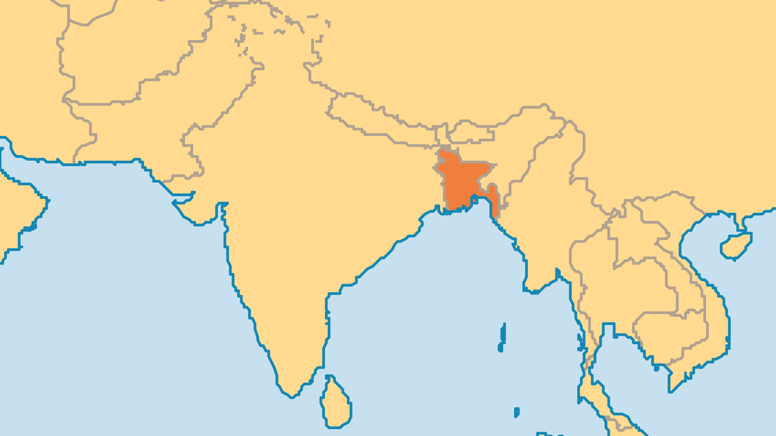
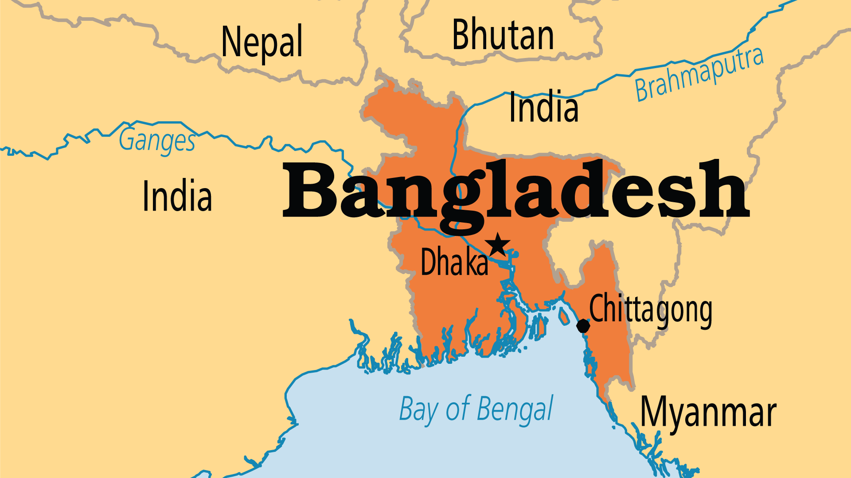
KEY STATS
Capital: | Dhaka
Population: | 175,686,900
Official Language: | Bangla ( Bengali); English also used
Languages: | 46
% Christian: | 0.7 %
% Evangelical: | 0.4 %
Largest Religion: | Muslim
% Largest Religion: | 89 %
% Unevangelized: | 50 %
Persecution Ranking: | 24/50

Slide 4

FOR PRAYER
The pressures on Bangladesh's poor hit a crisis point in 2024. Economic pressures and lack of jobs led to student protests which were met with deadly force. Mass protests broke out, the government collapsed, and the Prime Minister fled. The wealthy clans controlling the nation's politics had no solutions; pray that the interim government might find real answers. Bangladesh has few natural resources; around 25% of the population lives below the poverty line and this cycle will continue unless vital changes occur. Floods regularly devastate this nation that sits beside the gigantic Ganges and Brahmaputra Rivers. Pray for lasting transformation in this land.

Slide 5
FOR PRAYER
Pray for leadership for the churches. Earlier movements brought thousands of people into the Church. But the lack of trained, godly leadership eventually left many believers with a weak and shallow faith. Poverty limits the number of full-time ministers and theological students, but churches also lack spiritually mature lay leaders. In Bangladesh, as in any nation, robust discipleship processes would go a long way to solving these challenges.
Want to know more? Go to www.operationworld.org

Slide 6
FOR PRAYER
The Bengali, or Shaikh, people (240 million globally) remain the world's largest unreached group. Even 200 years after William Carey's mission to the Bengali who still honour his memory, a gospel breakthrough has not come. Pray for Bengali Muslims. Many follow a folk blend of Sufi Islam, indigenous cultures, and Hinduism. Most have never heard the true gospel. Pray for the few Bengali believers to depend on God in their poverty and to be strong when faced with persecution. Pray that they find community with believers from different backgrounds. Pray for Bengali Hindus (201 Hindu groups, of which 188 are unreached), who face violence and persecution as a religious minority.

