Slide 1




Slide 2


PRAYING FOR
BAHRAIN

Slide 3
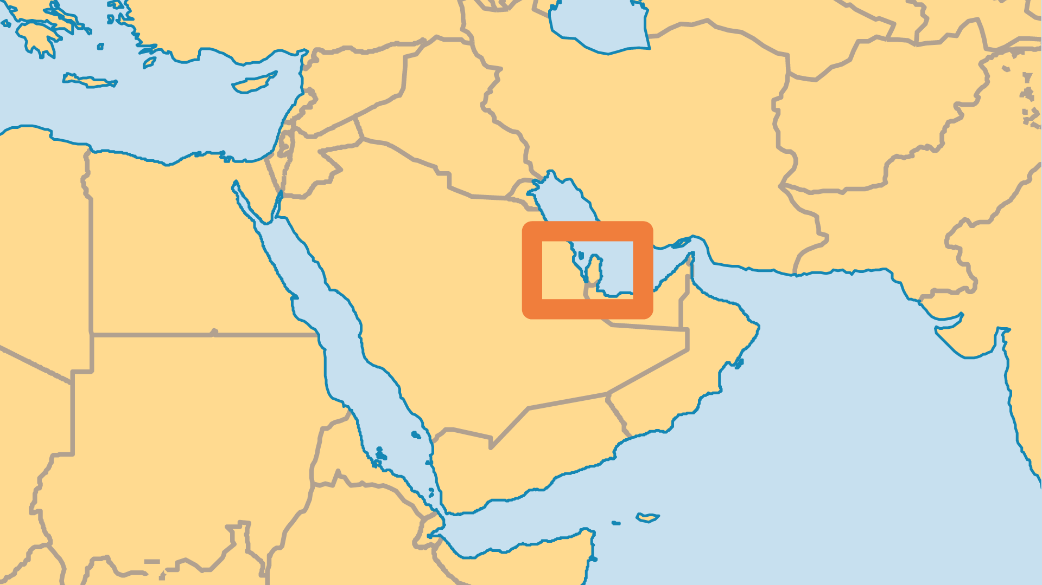
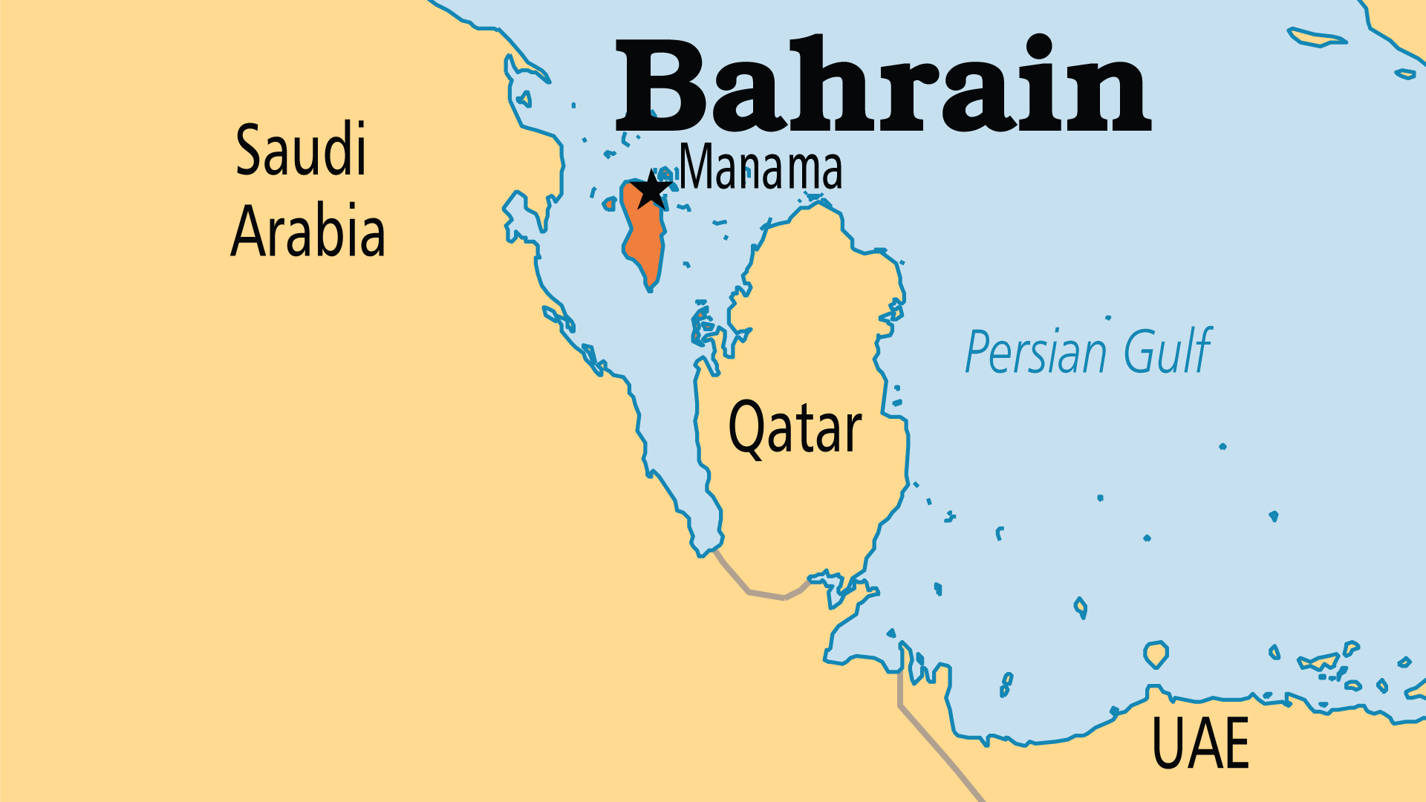
KEY STATS
Capital: | Manama
Population: | 1,643,332
% Urban: | 90.1 %
Official Language: | Arabic
Languages: | 12
Literacy Rate: | 95 %
HDI Ranking: | 35/193
% Christian: | 9.8 %
% Evangelical: | 2.9 %
Largest Religion: | Muslim
% Unevangelized: | 47 %

Slide 4

FOR PRAYER
Bahrain enjoys greater freedoms than almost all Gulf countries and therefore is spiritually strategic. Praise God for the local believers! Some worship with the various established churches, and others gather in more informal networks. Pray especially for unity and cooperation among these groups, as a testimony to their fellow Arabs. Many Saudis and Kuwaitis visit to enjoy the more relaxed environment. Pray for them to meet Christians and to encounter the gospel.
Want to know more? Go to www.operationworld.org

