Slide 1




Slide 2


PRAYING FOR
THE BAHAMAS

Slide 3
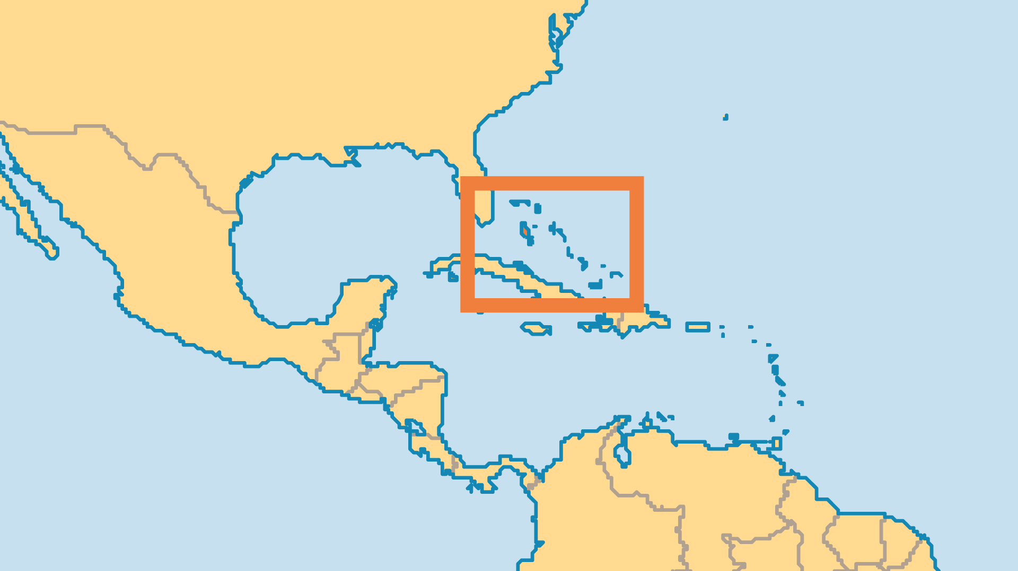
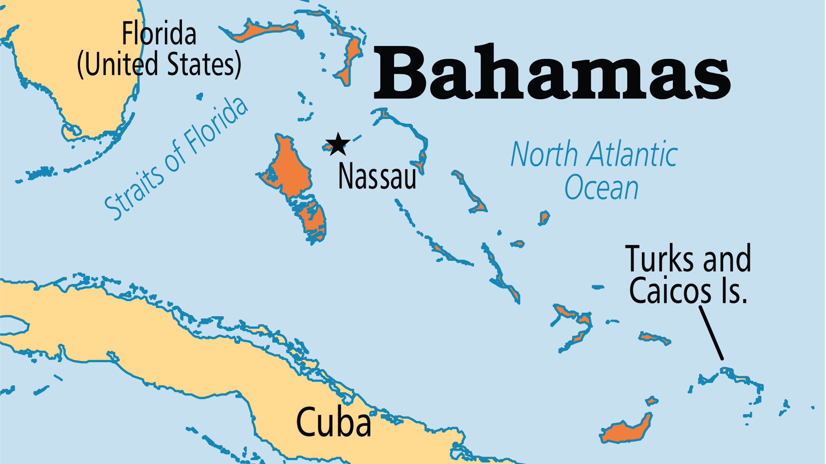
KEY STATS
Capital: | Nassau
Population: | 403,033
% Urban: | 83.9 %
Pop Under 15 Yrs: | 22.1 %
Official Language: | English
Languages: | 4
Literacy Rate: | 97 %
HDI Ranking: | 55/193
% Christian: | 94.7 %
% Evangelical: | 35.9 %
% Unevangelized: | 1 %

Slide 4

FOR PRAYER
Materialism, stimulated mostly by tourism, deeply affects all levels of society. Lowering standards of morality see a rise in births out of wedlock, drug use and violent crime (especially armed robbery). The staggering wealth of foreign residents and tax shelters display a different world from the average Bahamian, not to mention the even poorer Haitian immigrants. Pray for social righteousness and a government that works to serve all strata of society.
Want to know more? Go to www.operationworld.org

