Slide 1




Slide 2


PRAYING FOR
AZERBAIJAN

Slide 3
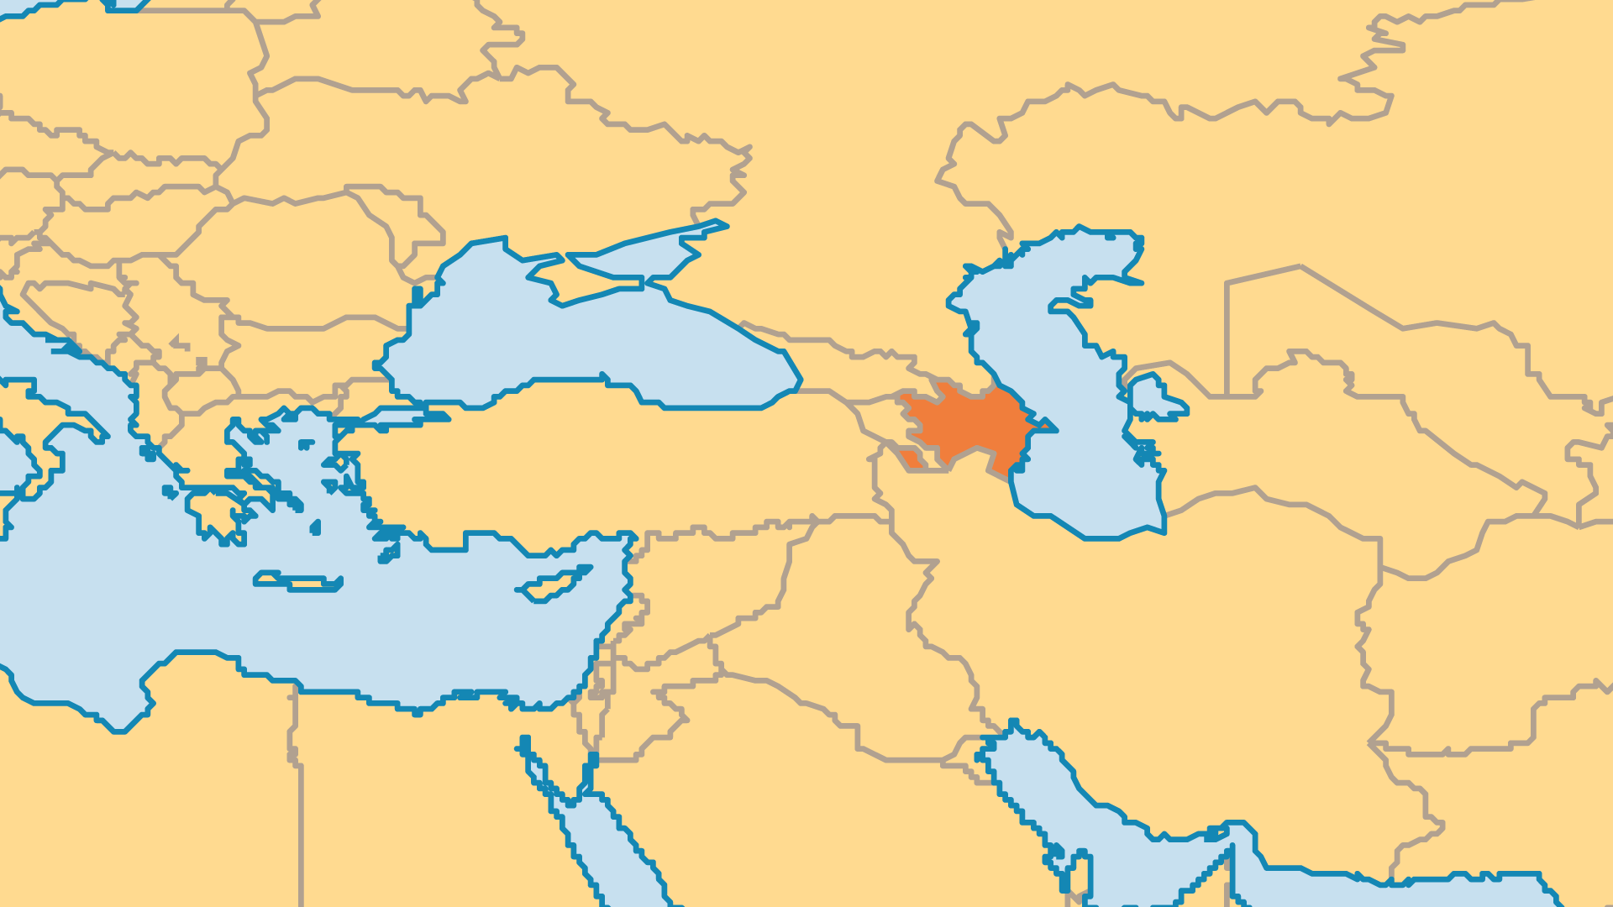
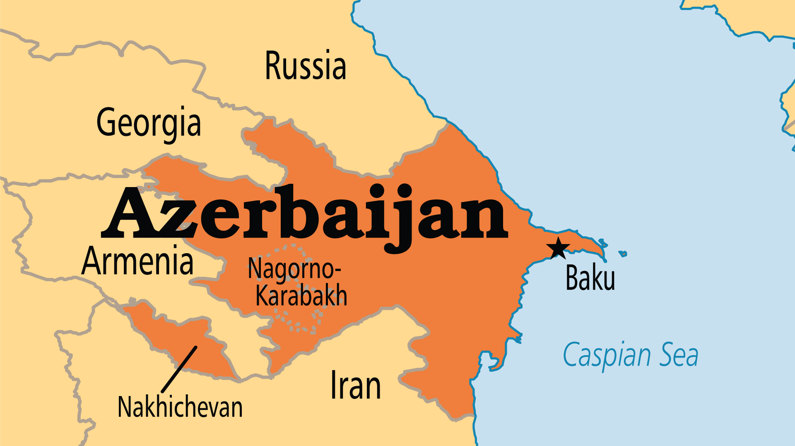
KEY STATS
Capital: | Baku
Population: | 10,397,713
% Urban: | 58.4 %
Official Language: | Azerbaijani
Languages: | 34
Literacy Rate: | 99 %
Life Expectancy: | 69.4 yrs (165th/236)
% Christian: | 2.7 %
% Evangelical: | 0.2 %
Largest Religion: | Muslim
% Unevangelized: | 59 %

Slide 4

FOR PRAYER
God raised up an Azeri Church, even amidst trials! Only 40 known Azeri believers lived in the country in 1991. Now there are more than 10,000, with the majority in Baku. Even more ethnic Azeris follow Christ inside of Iran. Some Azeri believers create their own music, literature, poetry, and other indigenous forms of worship. Even so, most Christians in Azerbaijan are primarily of foreign ethnicities. Pray for good fellowship among all the believers.
Want to know more? Go to www.operationworld.org

