Slide 1




Slide 2


PRAYING FOR
AUSTRIA

Slide 3
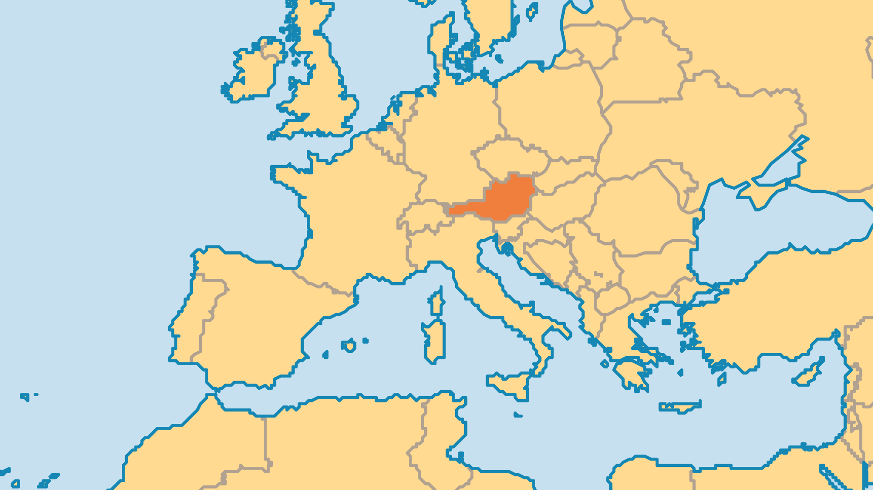
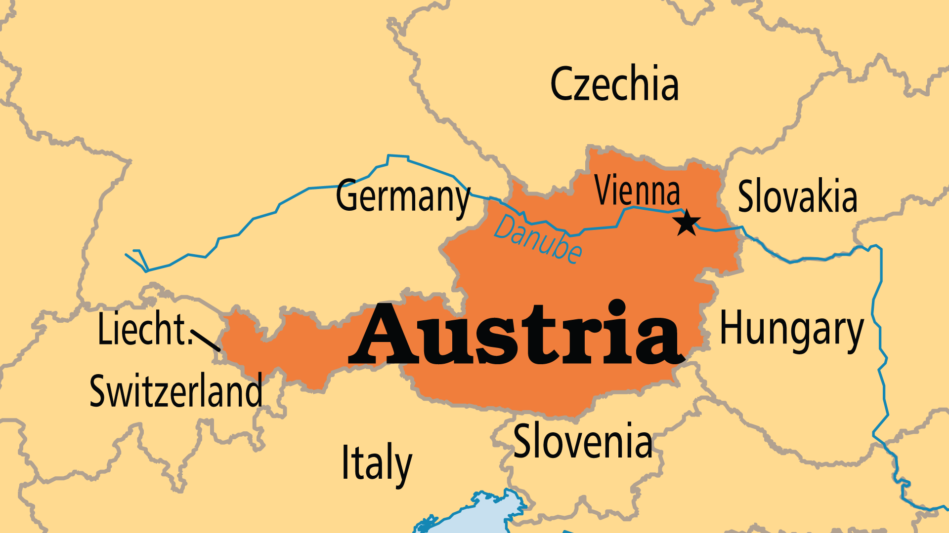
KEY STATS
Capital: | Vienna
Population: | 9,113,574
% Urban: | 60.1 %
Pop Under 15 Yrs: | 14.4 %
Official Language: | German
Languages: | 20
Life Expectancy: | 81.6 yrs (27th/236)
HDI Ranking: | 25/193
% Christian: | 82.6 %
% Evangelical: | 0.5 %
% Unevangelized: | 4 %

Slide 4

FOR PRAYER
A country of beautiful culture, music, art, and scenery, however Austria feels spiritually empty. Many believe in God (84%, which is high for Europe), but few know Jesus personally. Many leave the Catholic Church every year, despite the longstanding Catholic culture. Sex scandals among the clergy and the church tax (1% of taxable income) both contribute to this. People do not tend to seek God outside the Catholic Church. Let us pray fervently for open hearts to discover Jesus in new places, and for the further growth of the renewal movement within the Catholic Church.
Want to know more? Go to www.operationworld.org

Slide 5
FOR PRAYER
Almost all church growth occurs within evangelical/charismatic churches. Pentecostal churches almost doubled from 2000 to 2010. Prayer movements grew among teenagers and led to an Austrian Prayer Congress of over 1,000, that now meets bi-annually! Even so, evangelicals are only 0.5% of the population. Pray for God to multiply congregations that honour and proclaim the Lord Jesus Christ.
Want to know more? Go to www.operationworld.org

