Slide 1




Slide 2

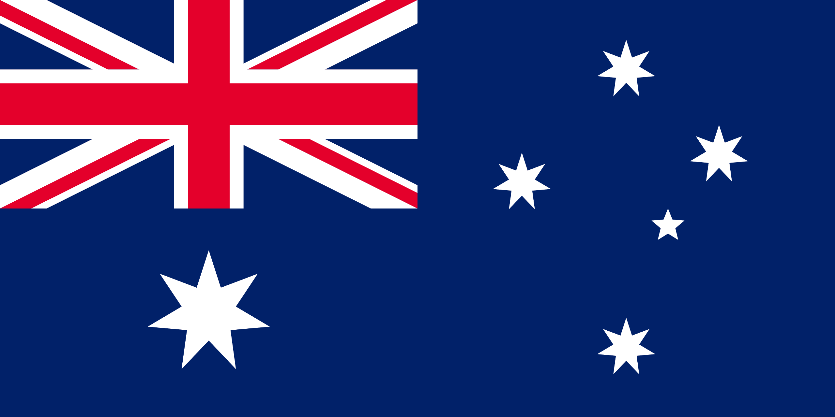
PRAYING FOR
AUSTRALIA

Slide 3
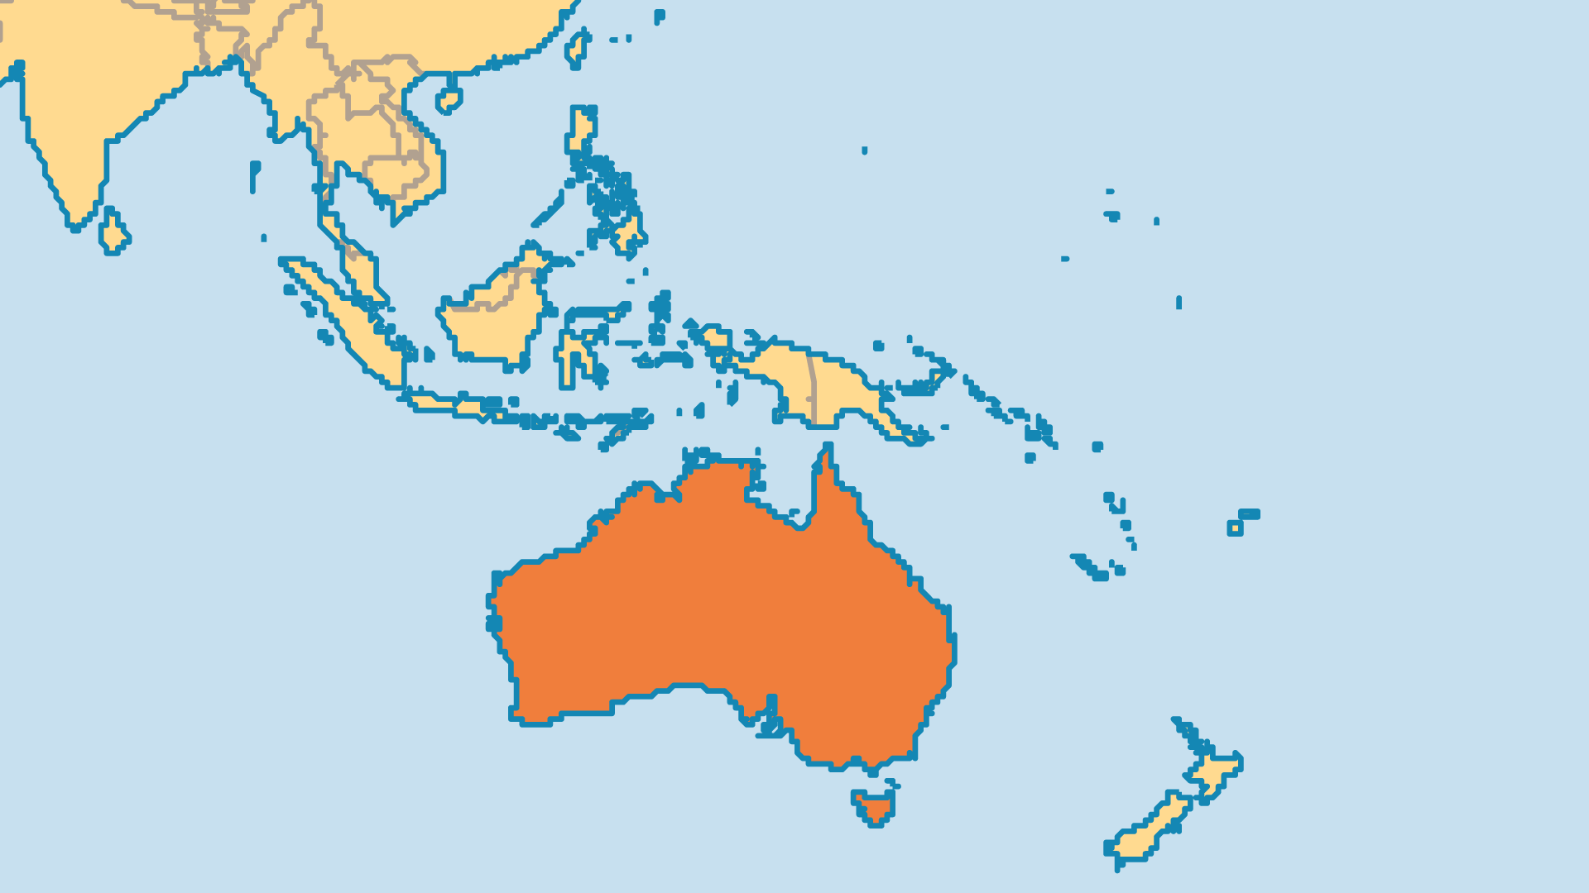
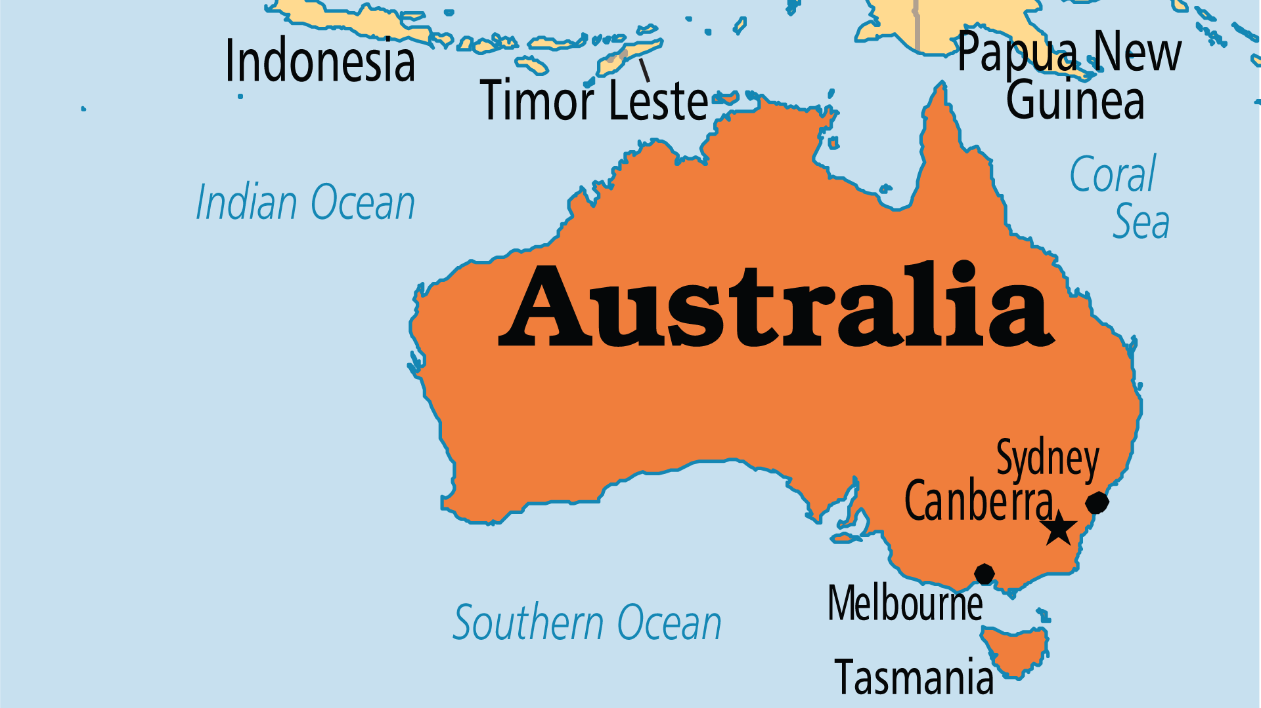
KEY STATS
Capital: | Canberra
Population: | 26,974,026
% Urban: | 86.9 %
Pop Under 15 Yrs: | 19.3 %
Official Language: | English. 20% use English as a second language
Languages: | 207
Life Expectancy: | 84.5 yrs (5th/236)
HDI Ranking: | 5/193
% Christian: | 44
% Evangelical: | 14.4 %

Slide 4

FOR PRAYER
Australia's precarious environment is overexploited in urban as well as rural settings. Amid Oceania's fragile ecology, Australia's future land and water use must be addressed. Recent drought and devastating fires raise questions as to the government's stewardship of the land and clean energy. Concerns arise about the need to prevent and combat bushfires and to develop sustainable agricultural and economic models. May repentance for careless and exploitative consumption, industry, and lifestyles bring about lasting change and healing - for the land, and in peoples' hearts. May the people of God passionately pursue His mandate of being good stewards of Creation.

Slide 5
FOR PRAYER
The Church in Australia faces a mighty challenge. Strong Christian influence declined as the country became more diverse in religions and more secular in its public life and laws. Many Australians see the Church as intolerant, abusive, and anti-progressive. Scandals in high-profile churches accelerated disillusionment and disgust with Christianity. Only 44% of the population claimed to be Christian in 2021, down from 71% in 1996! By the 2026 census, "No Religion" will almost certainly become the largest group in Australia. Pray for revival in the Church that will affect every area of Australian society.
Want to know more? Go to www.operationworld.org

