Slide 1




Slide 2


PRAYING FOR
ARUBA

Slide 3
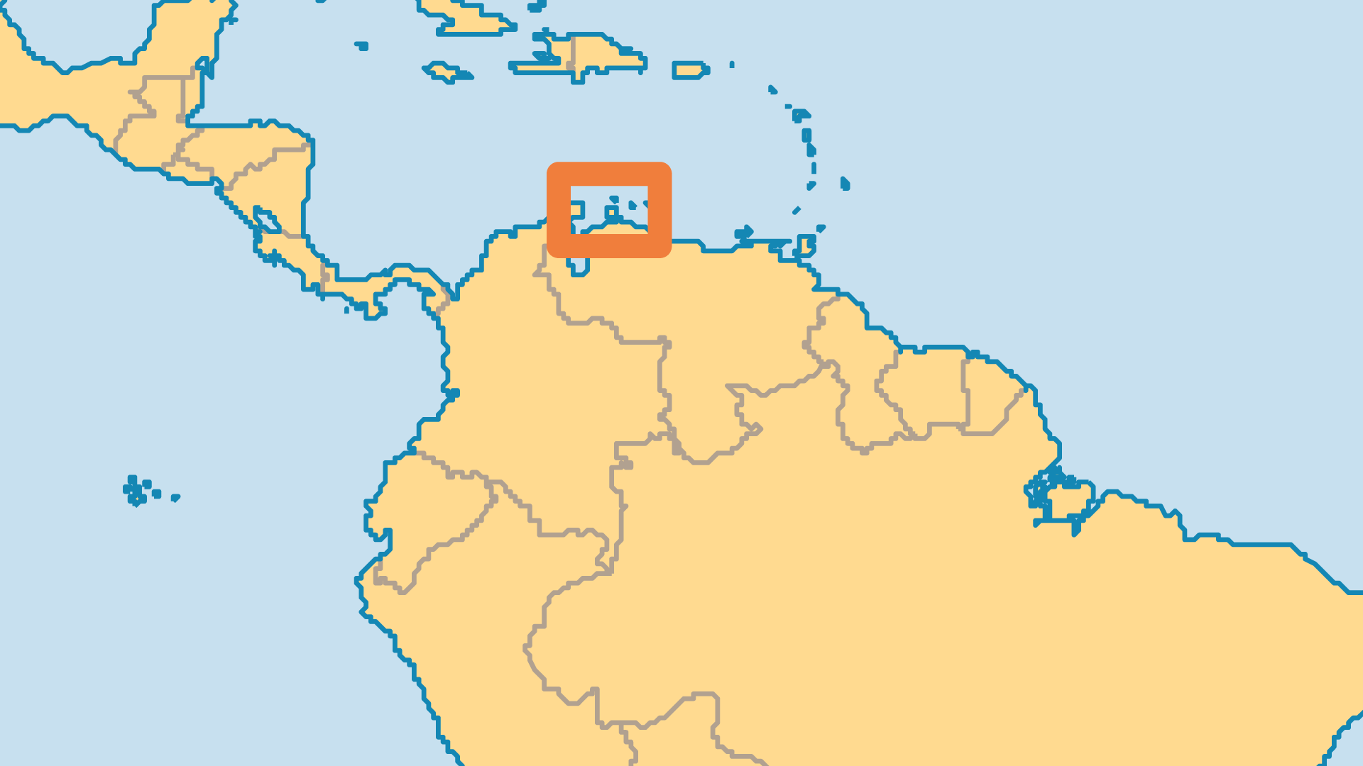
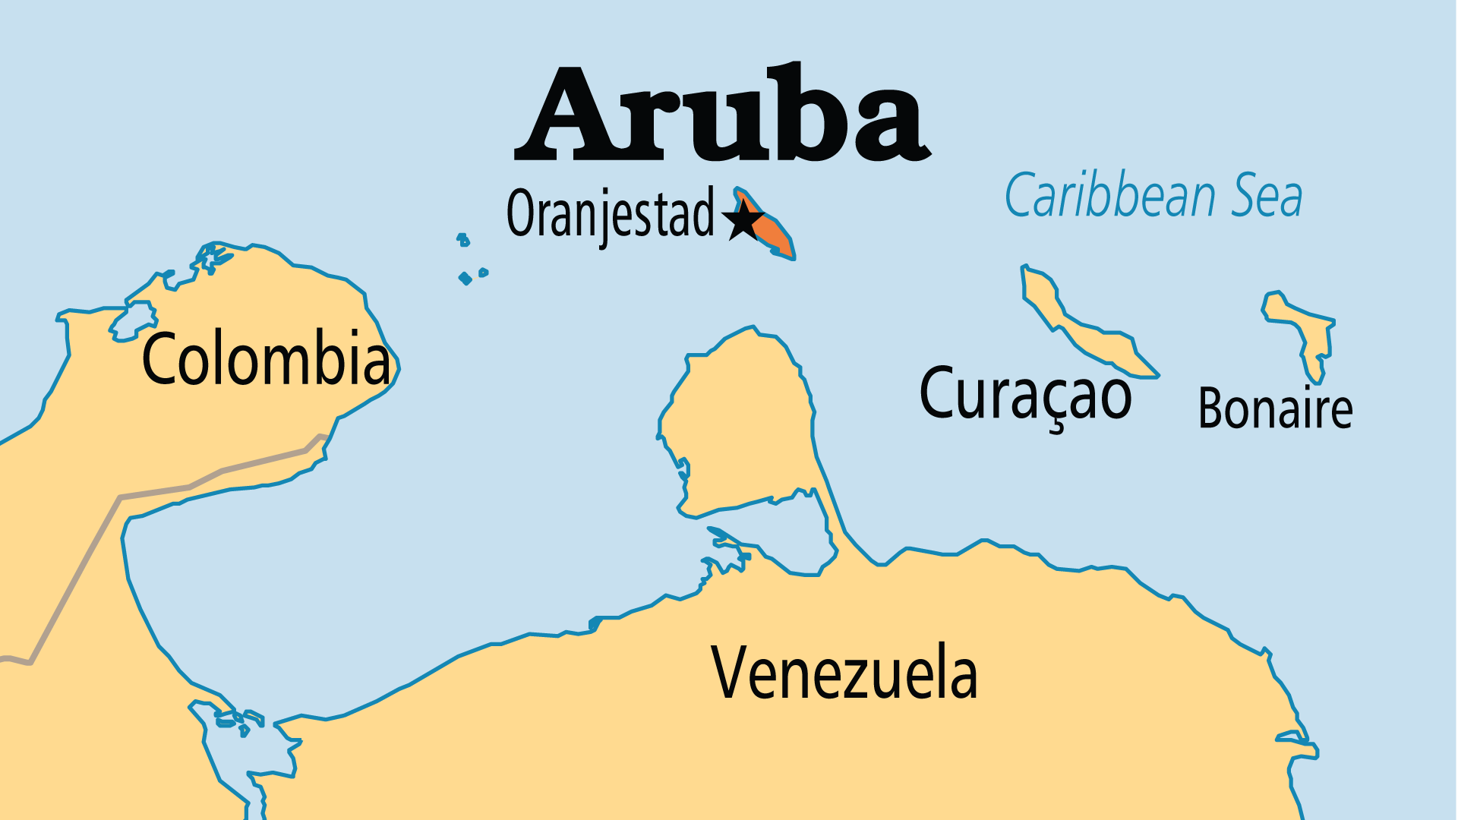
KEY STATS
Capital: | Oranjestad
Population: | 108,148
% Urban: | 44.7 %
Pop Under 15 Yrs: | 17.6 %
Official Language: | Dutch, Papiamento
Languages: | 5
Literacy Rate: | 98 %
% Christian: | 92.9 %
% Evangelical: | 7.6 %
People Groups: | 9
% Unevangelized: | 1 %

Slide 4

FOR PRAYER
The evangelical presence has grown, predominantly due to the more recent arrivals. Large numbers have immigrated from Latin America, the Caribbean and Asia, but evangelical growth is not even. There are several English-speaking churches and many congregations using Papiamento. Pray for a greater impact on the Asian immigrant population.
Want to know more? Go to www.operationworld.org

