Slide 1




Slide 2

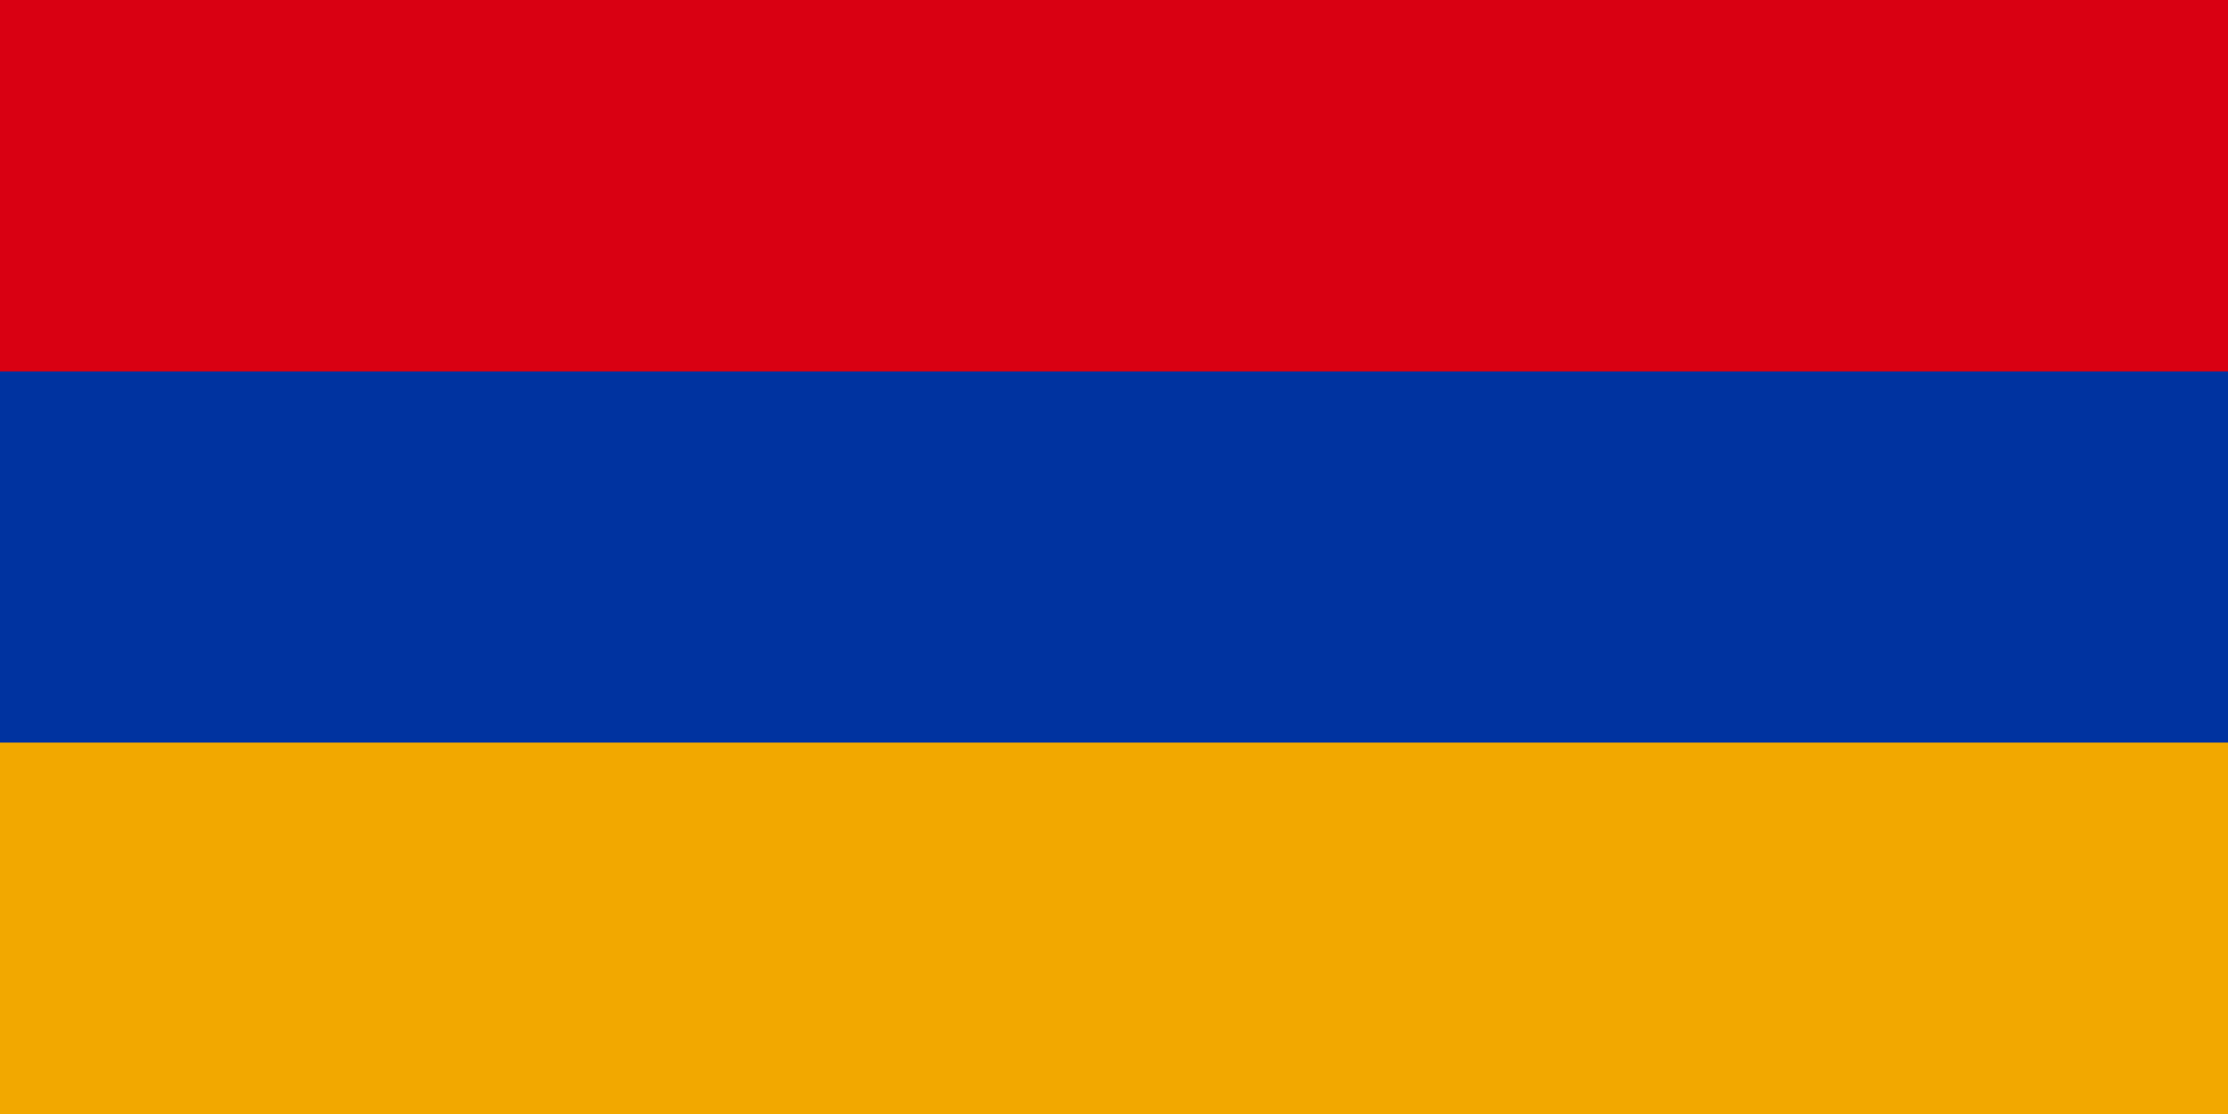
PRAYING FOR
ARMENIA

Slide 3
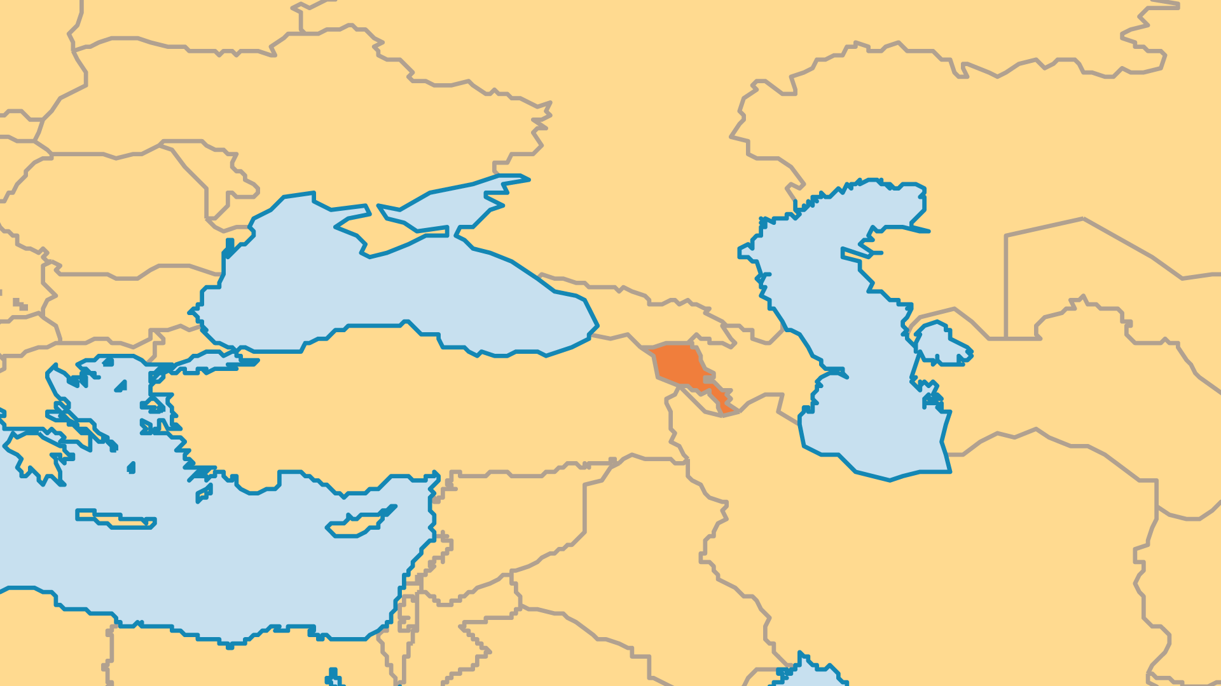
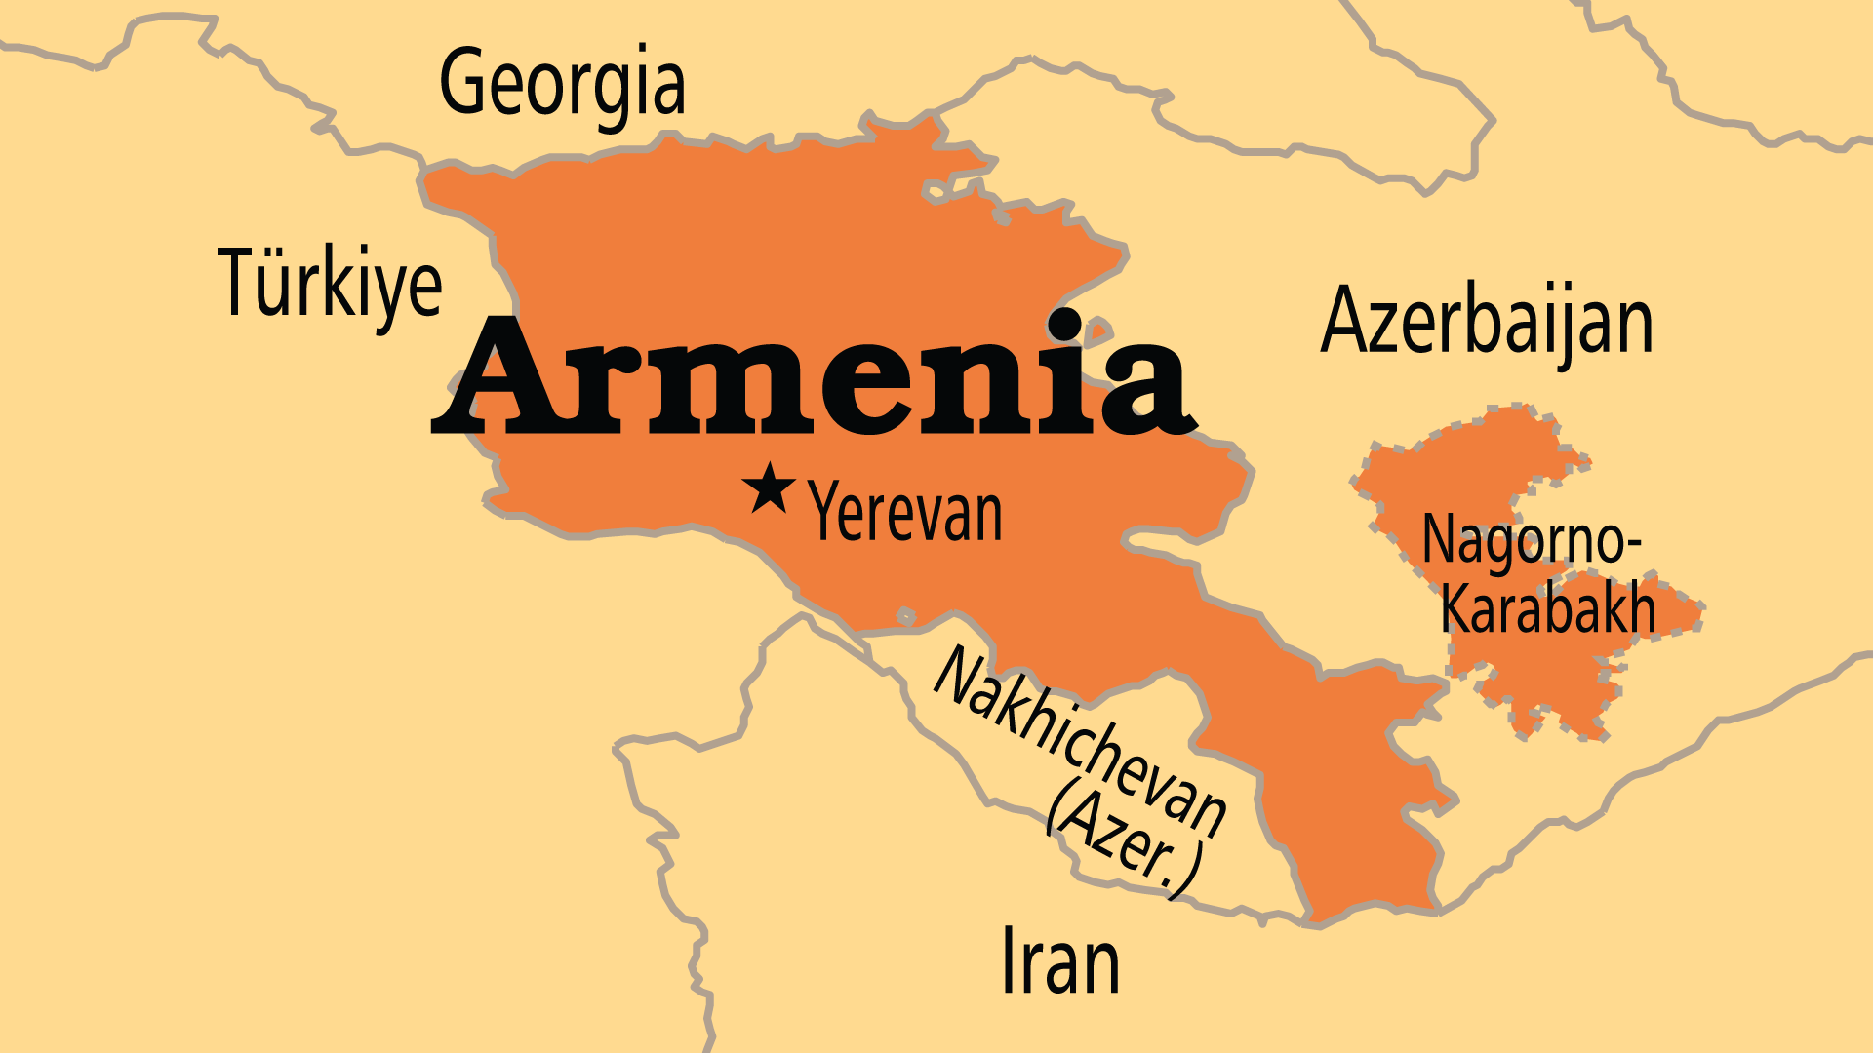
KEY STATS
Capital: | Yerevan
Population: | 2,952,365
% Urban: | 64.1 %
Pop Under 15 Yrs: | 20.8 %
Official Language: | Armenian
Languages: | 12
Literacy Rate: | 99 %
Life Expectancy: | 72 yrs (133rd/236)
% Christian: | 94.4 %
% Evangelical: | 8.7 %
% Unevangelized: | 1 %

Slide 4

FOR PRAYER
Centuries of bitter conflict, oppression, and massacres left Armenians with hateful mistrust of their neighbours. In early 20th century, the Turks killed up to 1.5 million Armenians in a merciless genocide, and late in that century, as well as 2020-2023, conflict with Azerbaijan resulted in the cleansing of Armenians from Nagorno-Karabakh. Armenians are shaken, and their traditional support from Russian has faded with the world's focus on Ukraine and Israel. Pray that the Lord's power for peace might reign over the region. Pray that Armenians might be free from fear of repeated genocide and would learn to forgive.

Slide 5
FOR PRAYER
Armenia was the world's first Christian nation, with a Christian legacy of more than 1,700 years. Praise God for the survival of the Armenian Church through the centuries, despite frequent and harsh oppression. Pray that Armenian Christians might become a source of light and blessing to the region. Evangelical Christianity thrives among the Armenian diaspora (up to 8 million), with many congregations in the Middle East, North America, and elsewhere. Armenian Christians, blessed with their Christian heritage, have begun to see their mission responsibility.
Want to know more? Go to www.operationworld.org

