Slide 1




Slide 2


PRAYING FOR
ARGENTINA

Slide 3
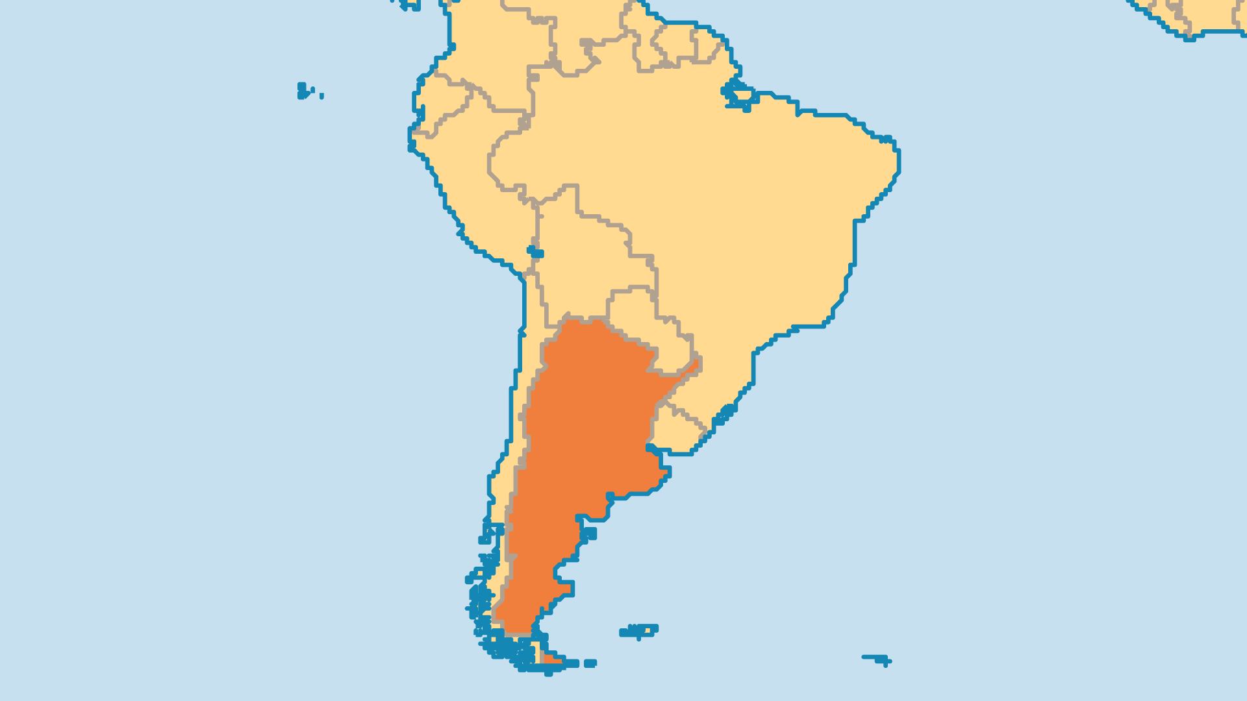
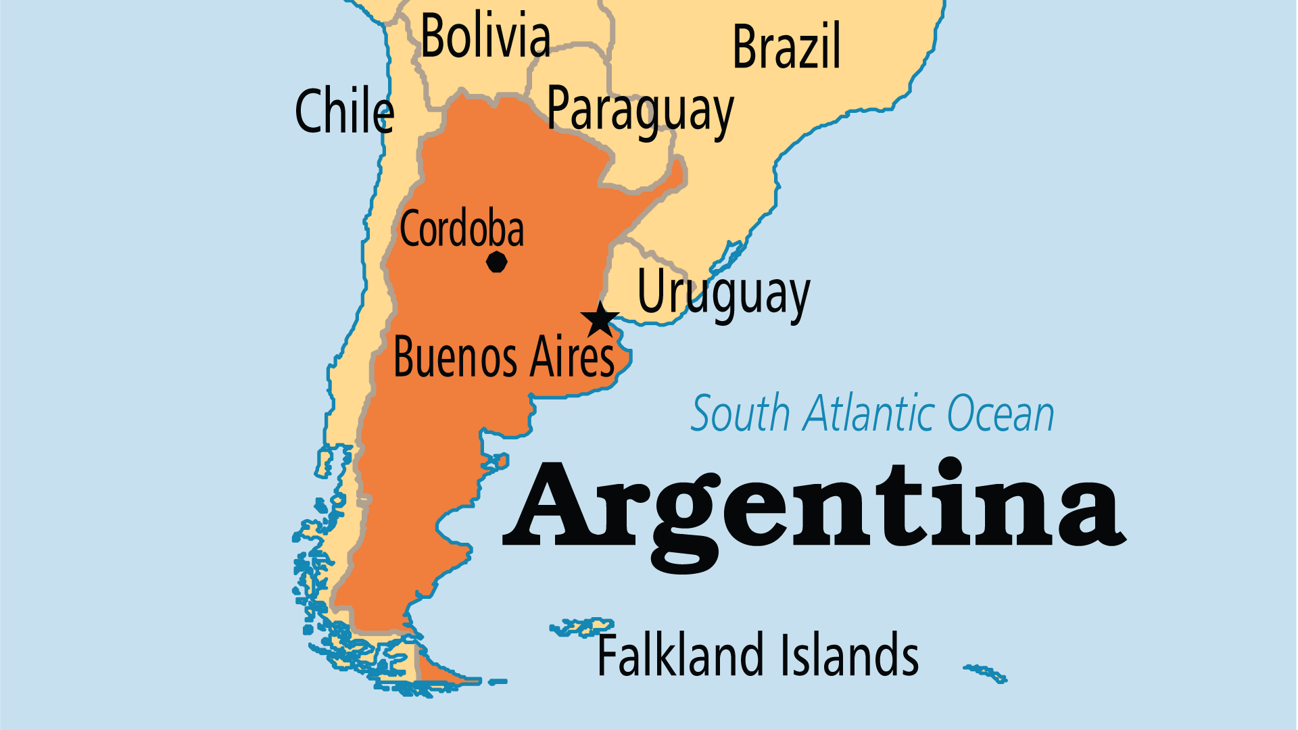
KEY STATS
Capital: | Buenos Aires
Population: | 45,851,378
% Urban: | 92.7 %
Official Language: | Spanish
Languages: | 40
Literacy Rate: | 98 %
Life Expectancy: | 75.4 yrs (82nd/236)
% Christian: | 89.3 %
% Evangelical: | 9.1 %
People Groups: | 85
% Unevangelized: | 1 %

Slide 4

FOR PRAYER
Buenos Aires is one of the world's largest urban areas, and the gospel does not reach many who live there. The cultured upper class are harder to reach. The Jewish community (one of the world's largest) has few believers. Some churches started work among the 500,000 slum dwellers, homeless, and street kids, but more work is needed. Chinese, Korean, Japanese, and Vietnamese communities continue to grow with only one agency reaching out to them. Pray for the many Christians in Buenos Aires to gain a passion for sharing the gospel across social, economic, and cultural boundaries.

Slide 5
FOR PRAYER
Evangelical Christians grew from less than 1 million in 1980 to possibly over 4.5 million by 2020. Renewal, evangelism, and prayer touched the nation. Argentinean evangelists, teachers, and missionaries touched the world! Godly, united leadership is necessary for the future. Pray for students in the hundreds of seminaries, Bible schools, and programmes. Local Councils of Pastors and the National Evangelical Alliance (ACIERA) now meet to pray and co-ordinate ministry. Pray that leaders may hear what the Spirit speaks to the Church, and act together in faith.
Want to know more? Go to www.operationworld.org

