Slide 1




Slide 2


PRAYING FOR
ANTIGUA AND BARBUDA

Slide 3
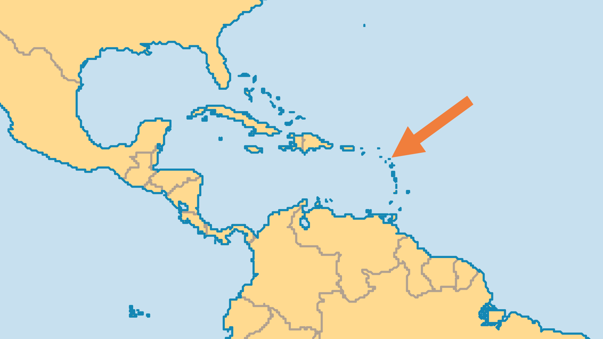
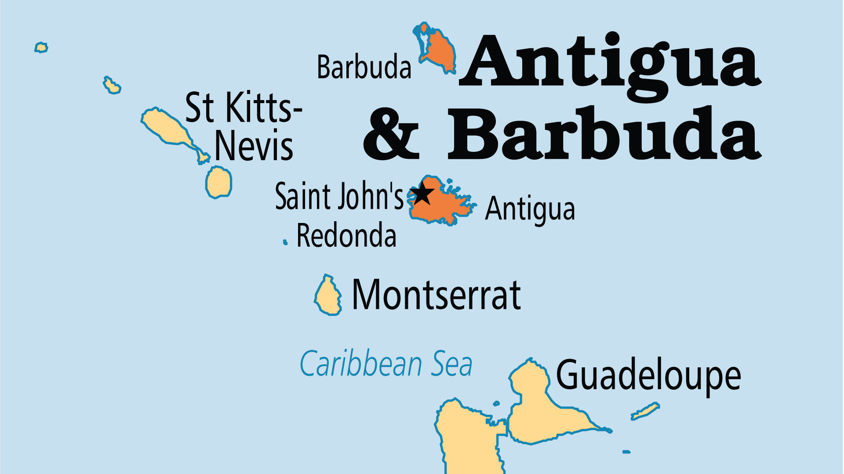
KEY STATS
Capital: | St. John's
Population: | 94,209
% Urban: | 24.4 %
Official Language: | English
Languages: | 4
Literacy Rate: | 97 %
Life Expectancy: | 78.5 yrs (58th/236)
% Christian: | 92.5 %
% Evangelical: | 19.9 %
Largest Religion: | Christian

Slide 4

FOR PRAYER
Antiguans are almost all Christian by background, including many evangelicals, but complacency prevails in the face of serious moral and spiritual challenges. Pray for revival that galvanizes Christians to prayer, and for involvement that impacts their society.
Want to know more? Go to www.operationworld.org

