Slide 1




Slide 2


PRAYING FOR
ANGUILLA

Slide 3
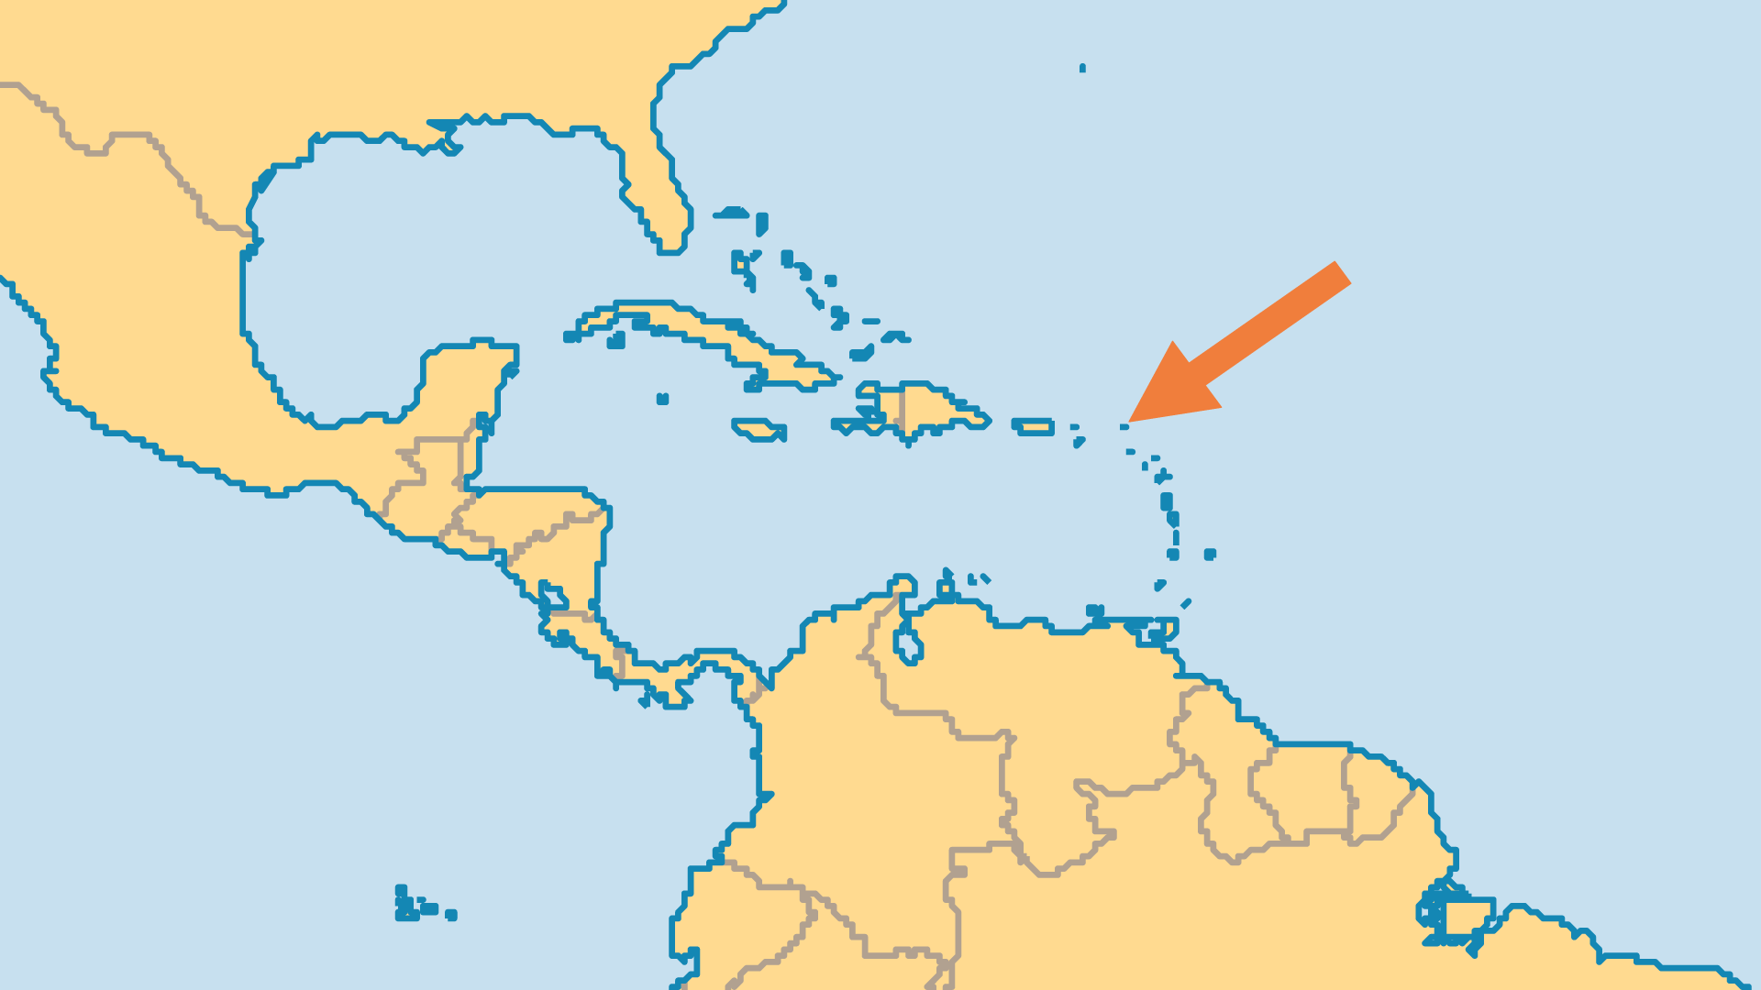
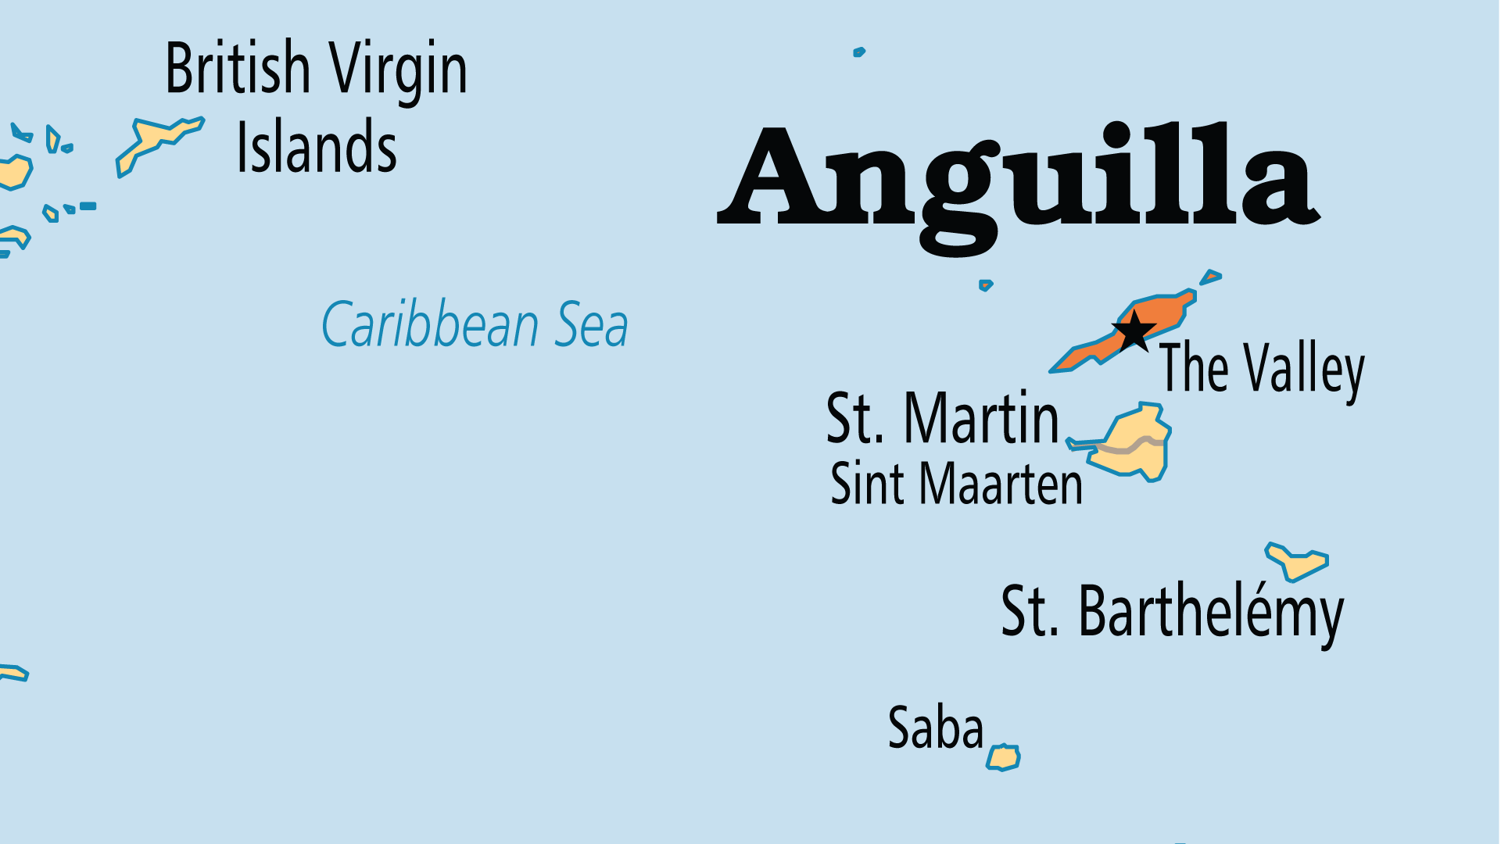
KEY STATS
Capital: | The Valley
Population: | 14,728
% Urban: | 100 %
Official Language: | English
Languages: | 3
Literacy Rate: | 95 %
Life Expectancy: | 76.6 yrs (73rd/236)
% Christian: | 90 %
% Evangelical: | 17.2 %
% Unevangelized: | 1 %

Slide 4

FOR PRAYER
Anguilla is a remnant of a bygone era as a little colonial outpost. Pray that this small island and its churches may not be bypassed by the Holy Spirit. Pray that religious traditions might be infused with real spiritual life.
Want to know more? Go to www.operationworld.org

