Slide 1




Slide 2

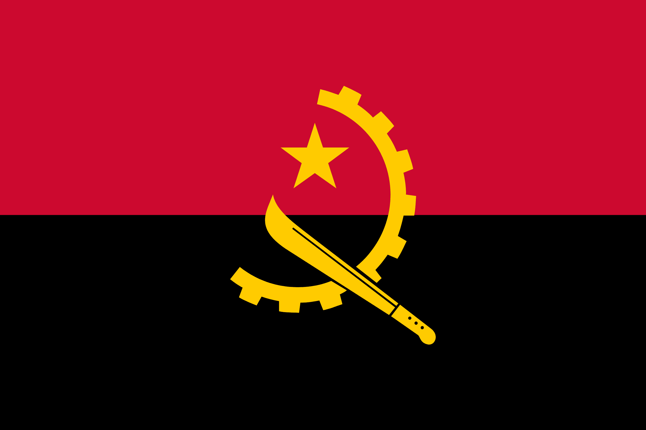
PRAYING FOR
ANGOLA

Slide 3
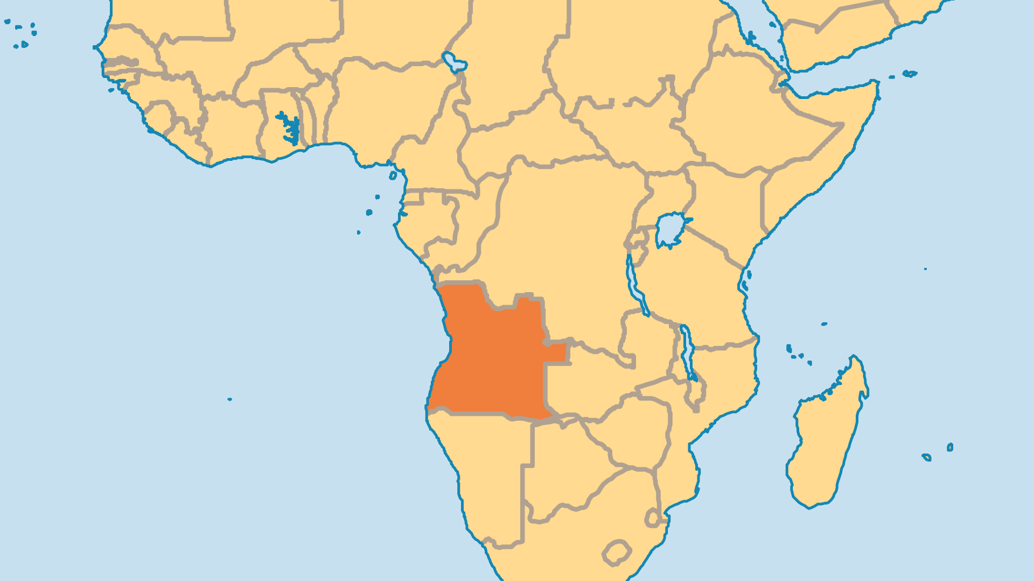
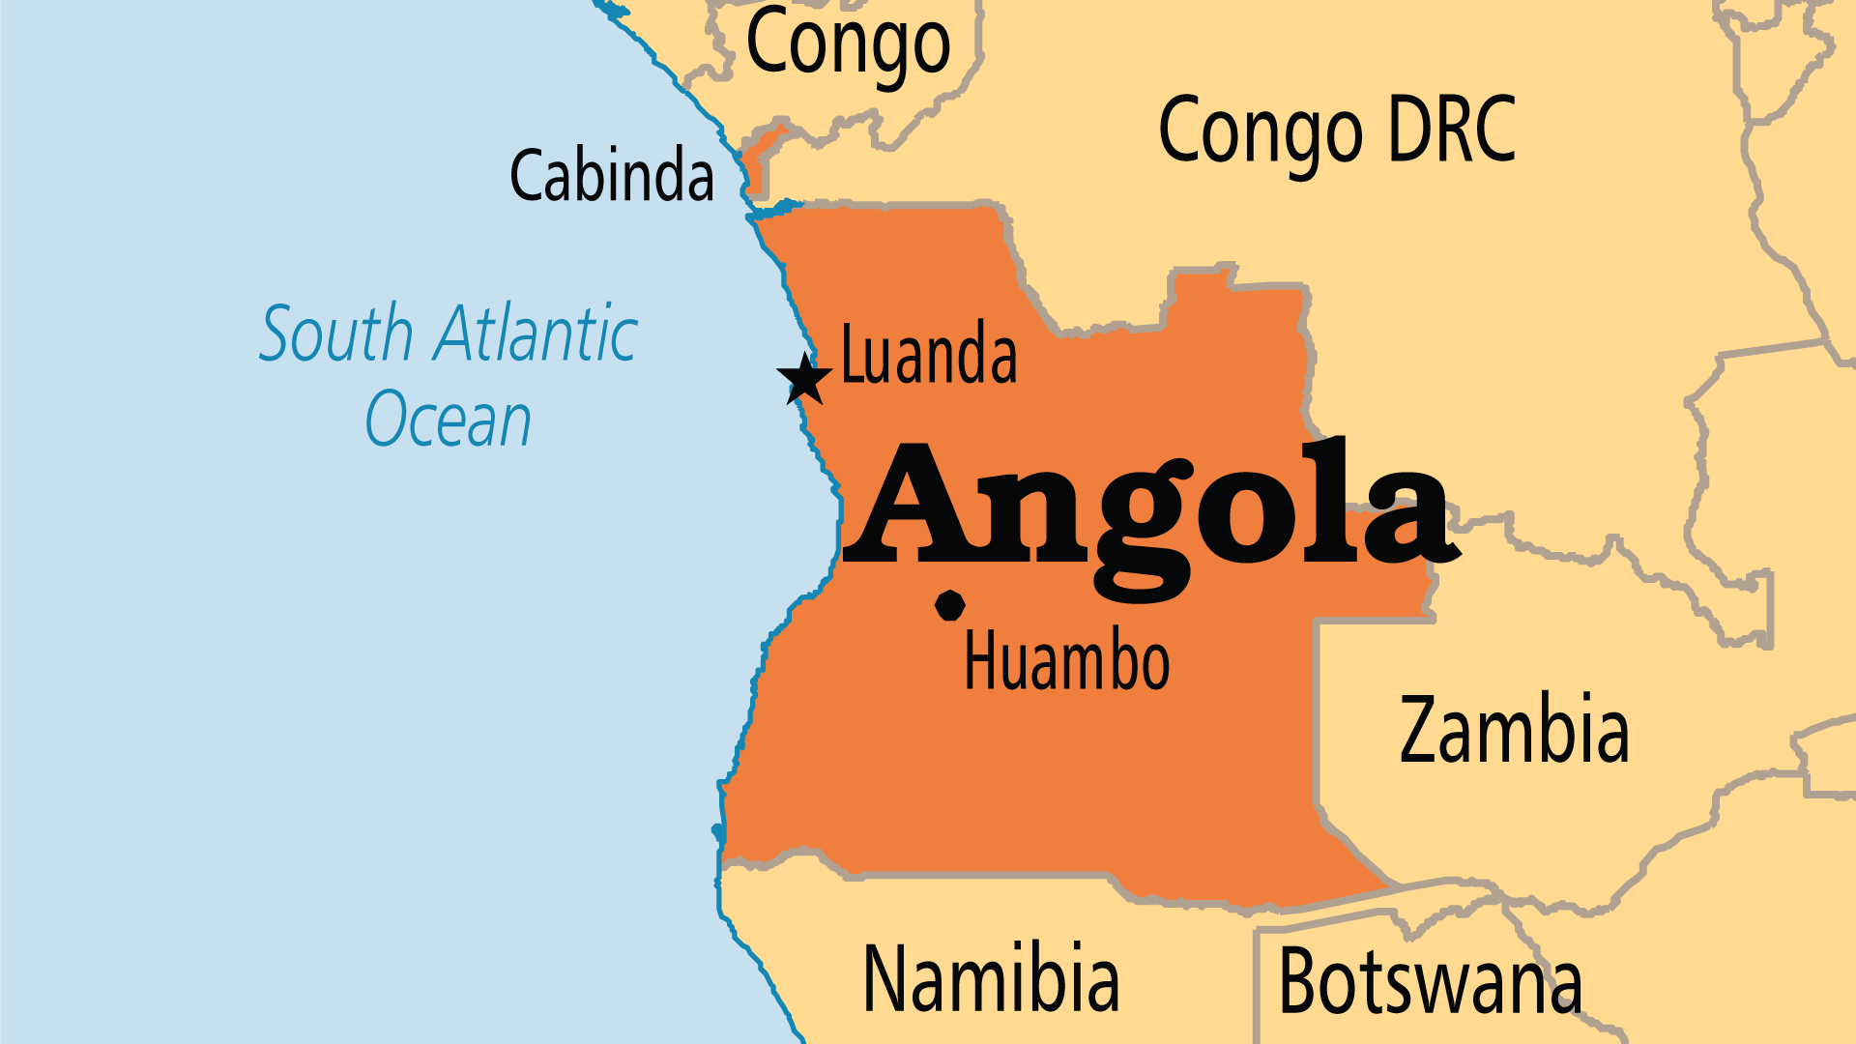
KEY STATS
Capital: | Luanda
Population: | 39,040,039
Pop Under 15 Yrs: | 47 %
Official Language: | Portuguese
Languages: | 41
Life Expectancy: | 61.6 yrs (210th/236)
HDI Ranking: | 148/193
% Christian: | 94.1 %
% Evangelical: | 22.5 %
People Groups: | 62
% Unevangelized: | 2 %

Slide 4

FOR PRAYER
Angola continues on the long road to recovery after the devastation of forty years of almost constant war. Innocent civilians suffered most. The spiralling cost of living in the capital city (due to oil money) starkly contrasts with the deep poverty of most rural areas as the gap between the rich and poor gets wider and wider. 15 million people live in extreme poverty. Pray that the Church will continue to be at the forefront of combatting not just poverty, but the trauma that millions suffered during the decades of violence and destruction.
Want to know more? Go to www.operationworld.org

Slide 5
FOR PRAYER
Biblical Christianity grew, even amidst war and poverty! The first president, a Marxist, vowed to eradicate Christianity in 20 years. He failed! The number of evangelicals grew 4 times larger from 1990 to 2010, and it continues to grow today. The Church needs much prayer to overcome the wounds of past conflict. Pray for forgiveness and love in action. Only a few congregations have trained pastors. False beliefs, ignorance of the Bible, witchcraft, and animistic practices pollute many lives and churches. Islam grows with its simple message and foreign financial support. Pray for Christian unity, holy living, and biblical faith.

