Slide 1




Slide 2

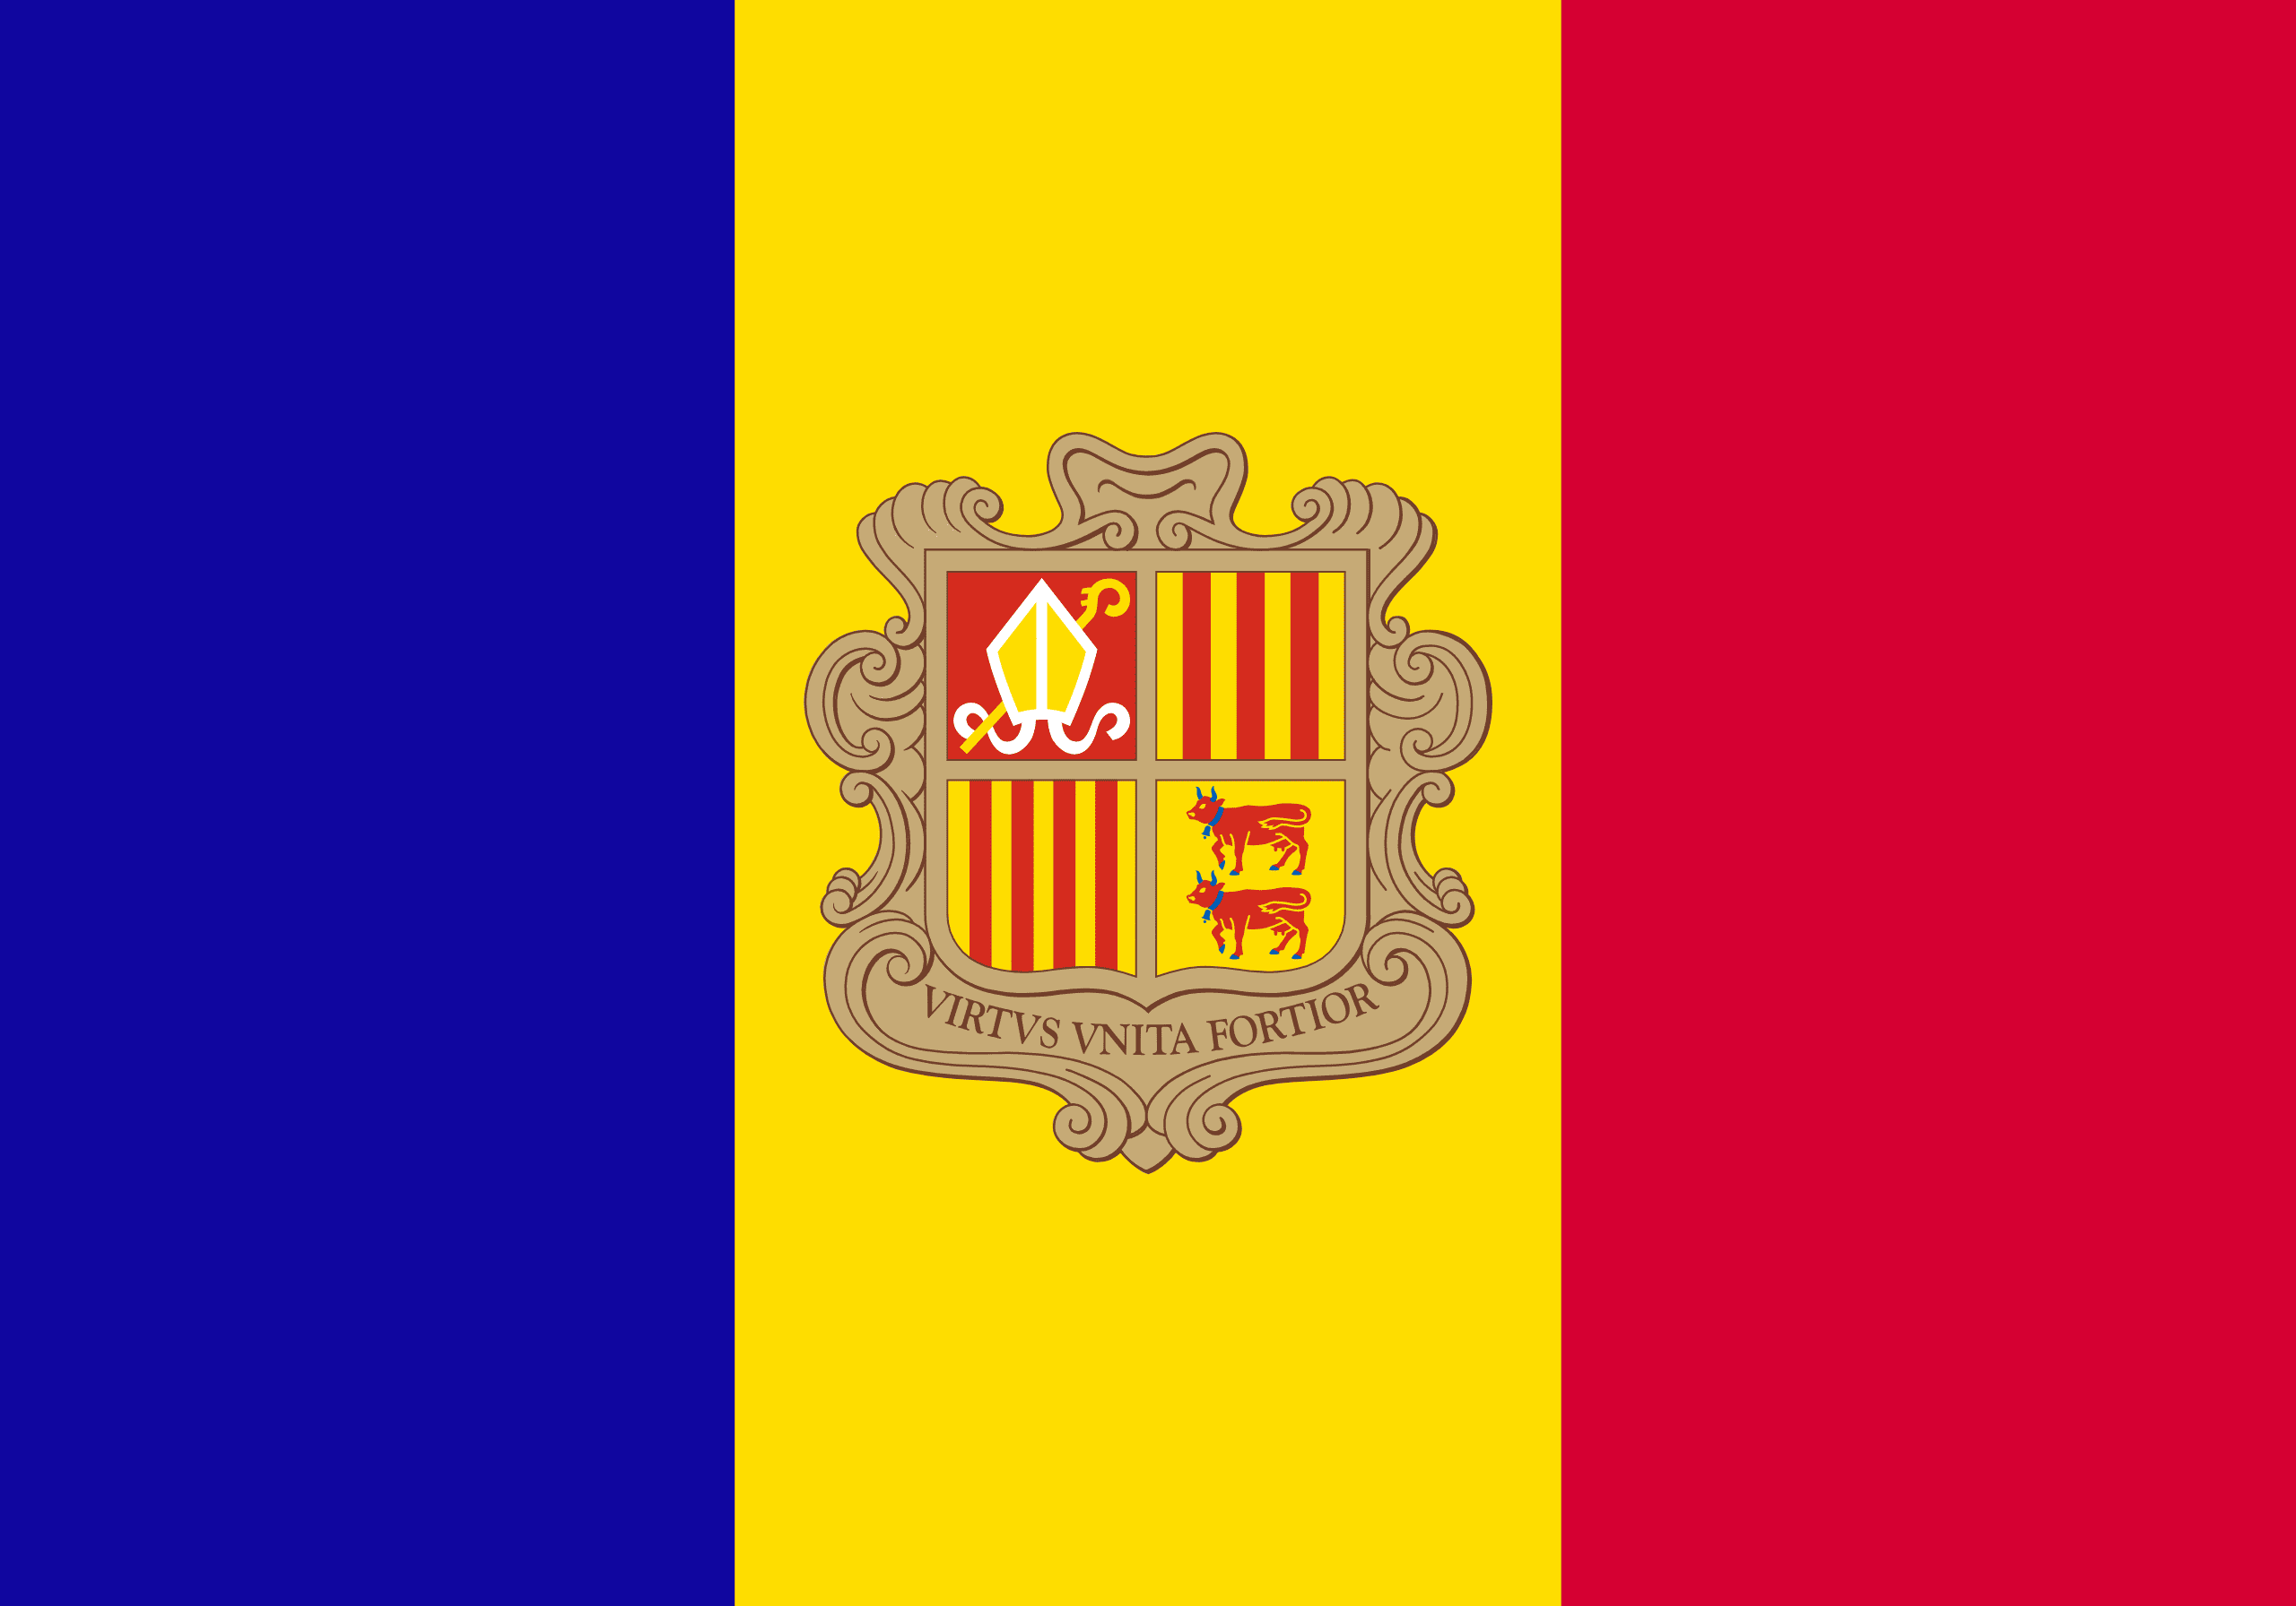
PRAYING FOR
ANDORRA

Slide 3
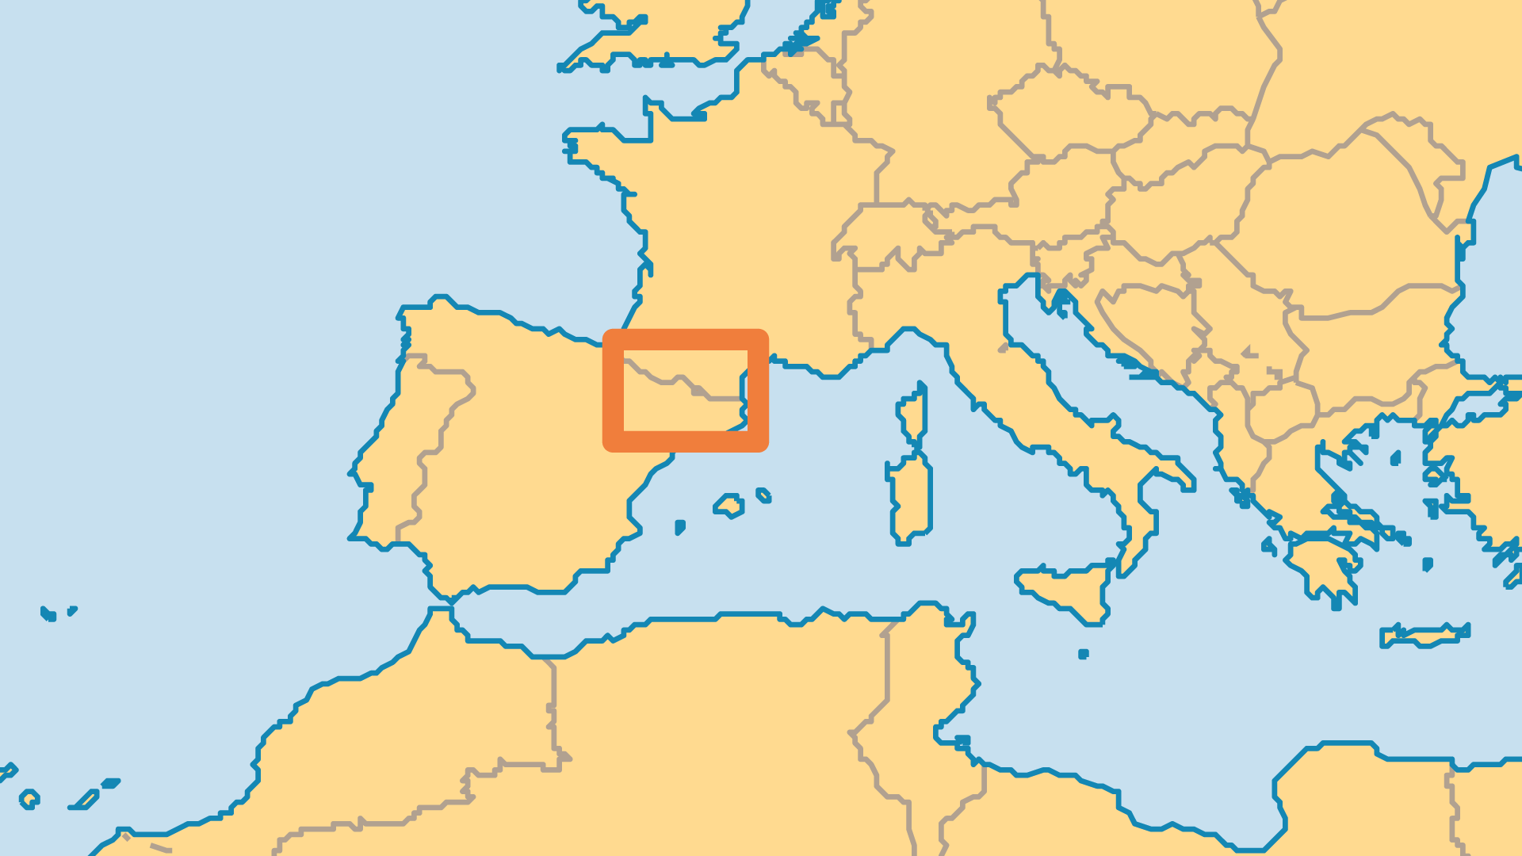
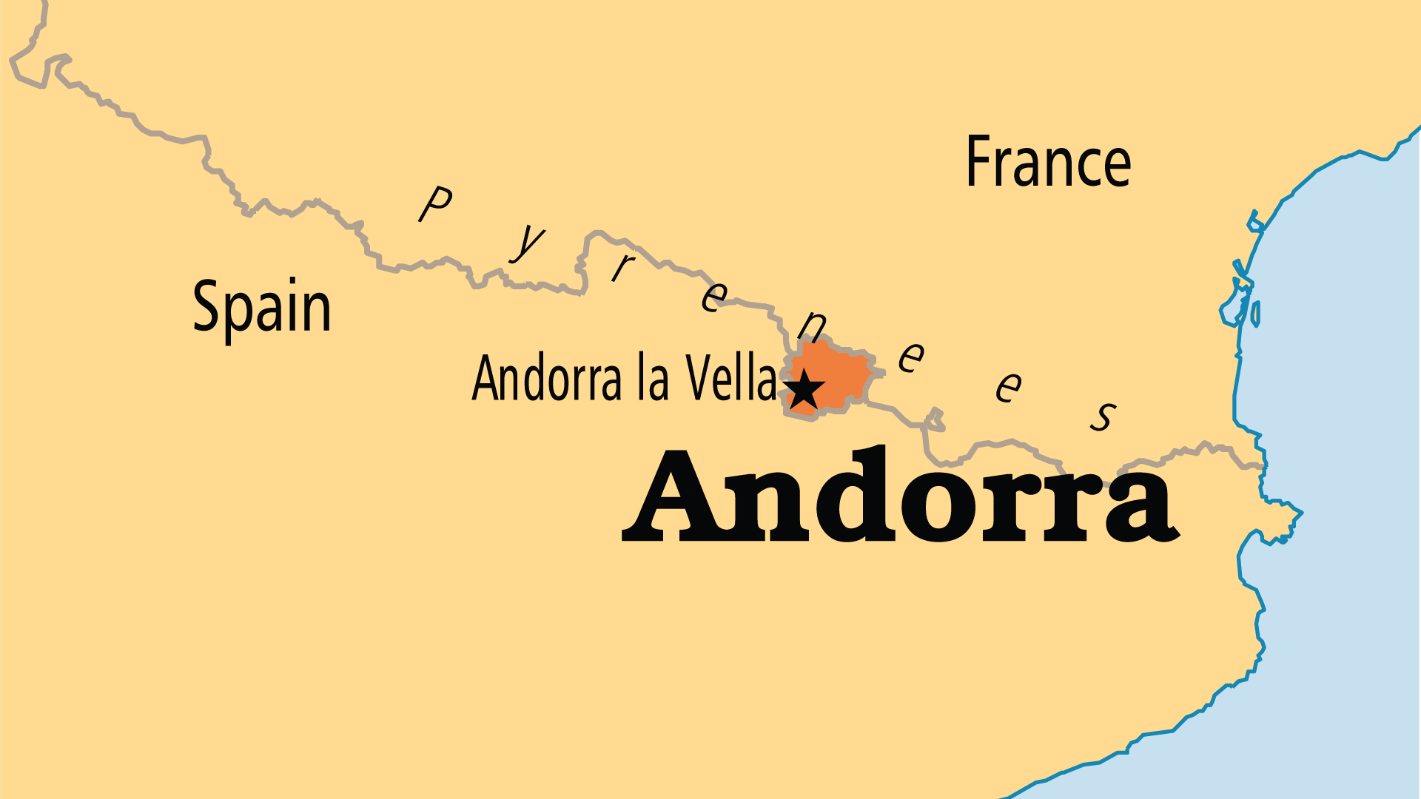
KEY STATS
Capital: | Andorra la Vella
Population: | 82,905
% Urban: | 87.7 %
Official Language: | Catalan
Languages: | 5
Literacy Rate: | 99 %
Life Expectancy: | 80.4 yrs (41st/236)
% Christian: | 90.8 %
% Evangelical: | 0.4 %
Largest Religion: | Christian
% Unevangelized: | 2 %

Slide 4

FOR PRAYER
Materialism holds Andorra in a tight grip. Formerly a smugglers' refuge, Andorra now attracts well-heeled tourists, financiers and those taking advantage of duty-free goods. Pray that empty materialism would be seen as the ultimately unfulfilling falsehood that it is. Pray for the witness of the handful of churches in this land.
Want to know more? Go to www.operationworld.org

