Slide 1




Slide 2


PRAYING FOR
AMERICAN SAMOA

Slide 3
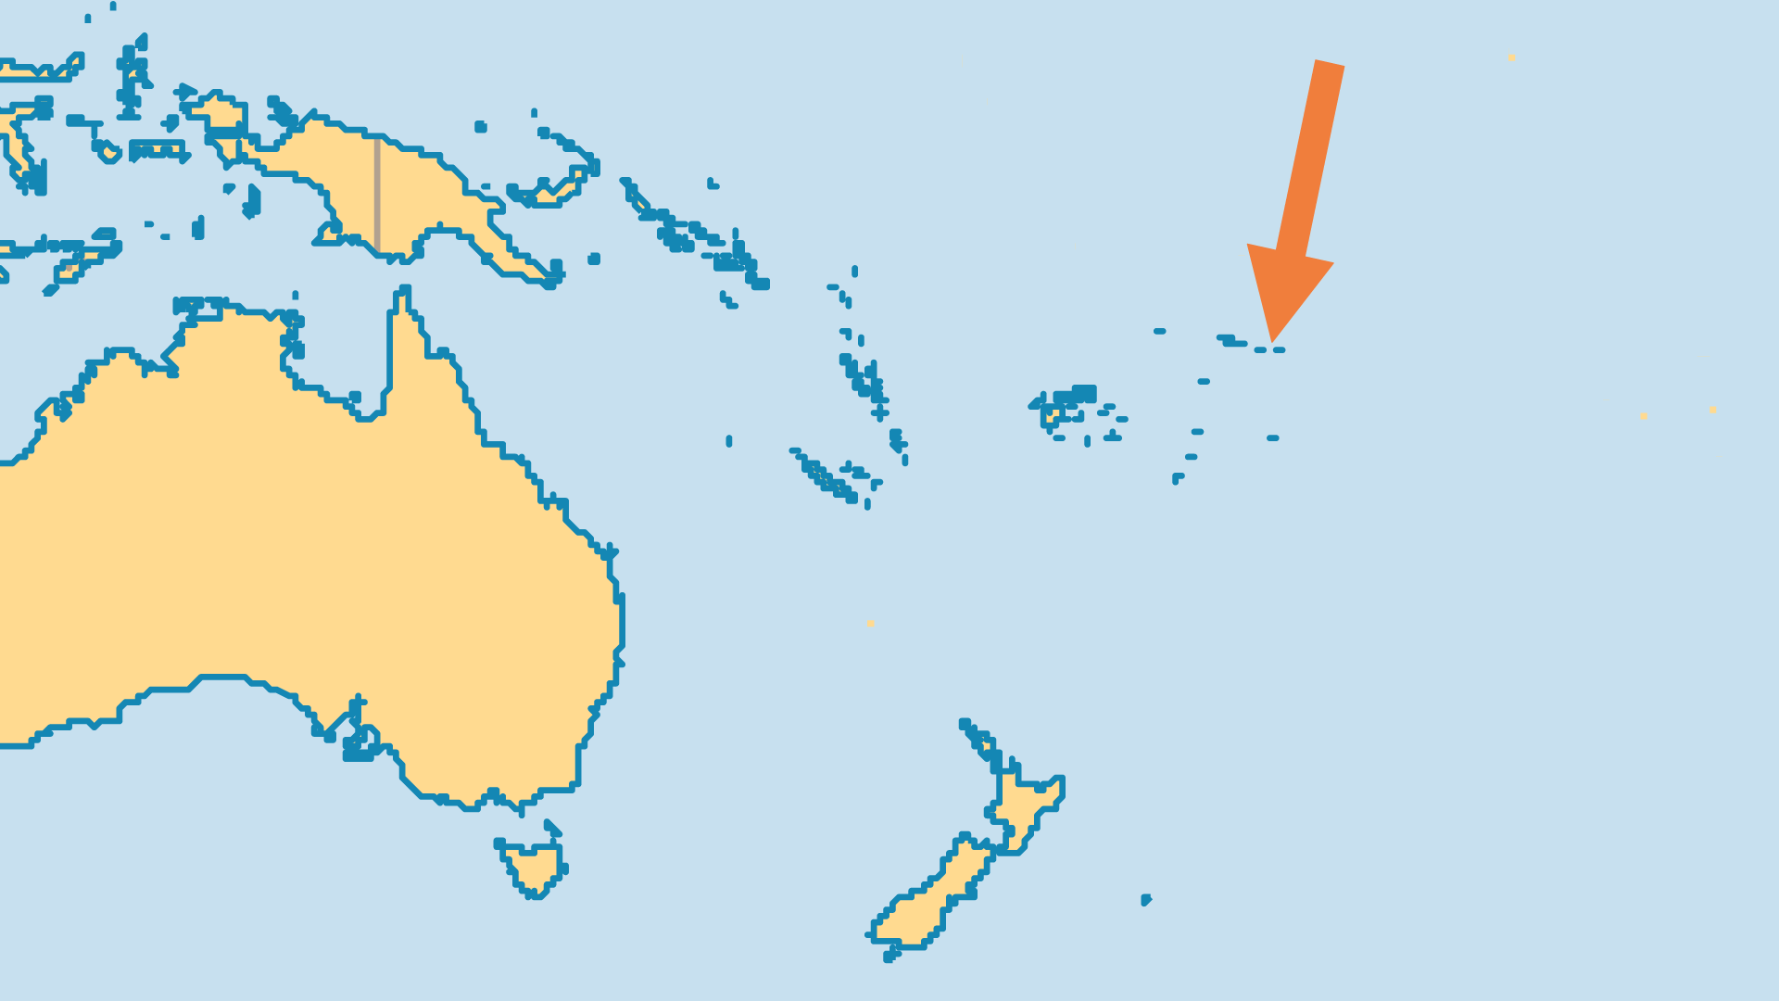
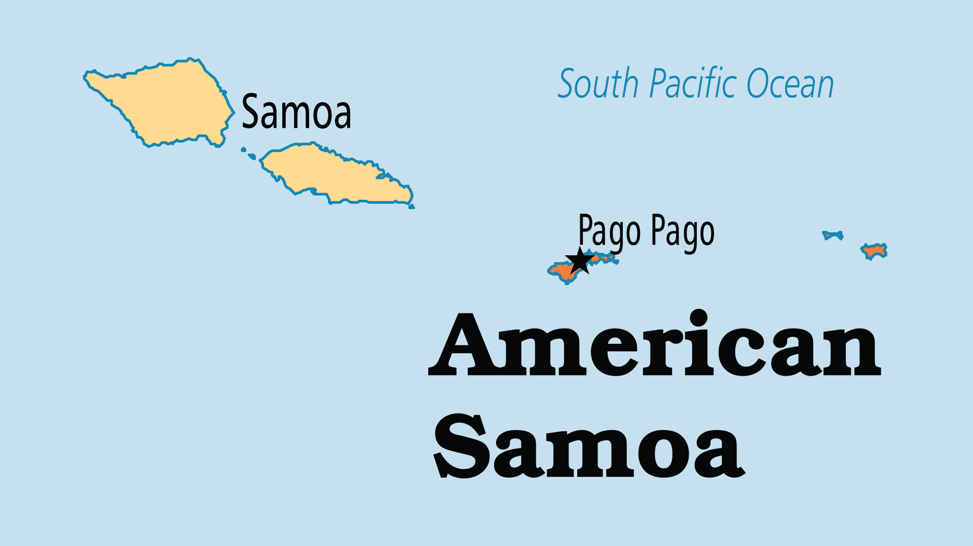
KEY STATS
Capital: | Pago Pago
Population: | 46,029
% Urban: | 87.3 %
Official Language: | Samoan, English
Languages: | 6
Literacy Rate: | 97 %
% Christian: | 95.1 %
% Evangelical: | 21.3 %
Largest Religion: | Christian
% Unevangelized: | 1 %

Slide 4

FOR PRAYER
Praise God for the evangelical ministries and churches making an impact for the Lord. Evangelical groups, especially Assemblies of God, have grown rapidly. Also, YWAM (Youth With A Mission) has a base in the islands.
Want to know more? Go to www.operationworld.org

