Slide 1




Slide 2

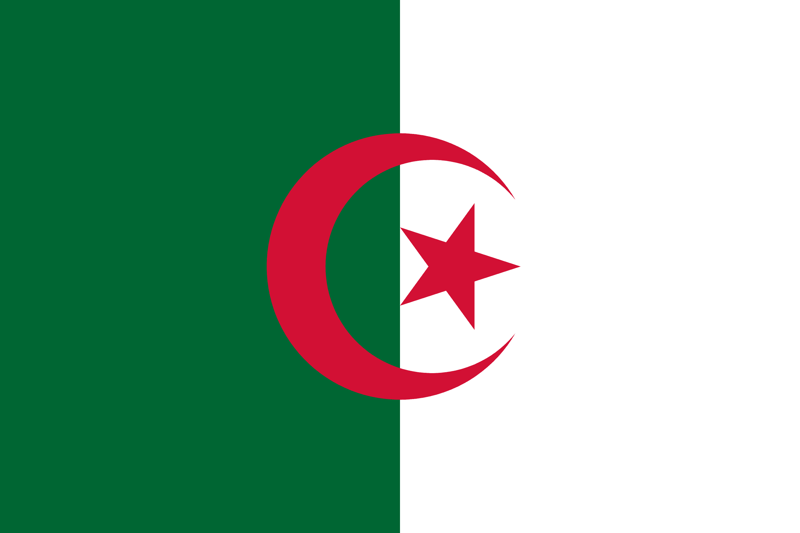
PRAYING FOR
ALGERIA

Slide 3
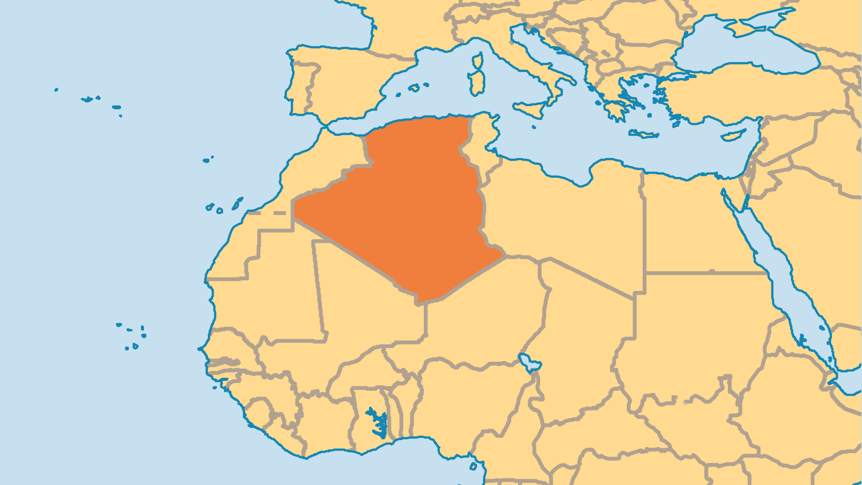
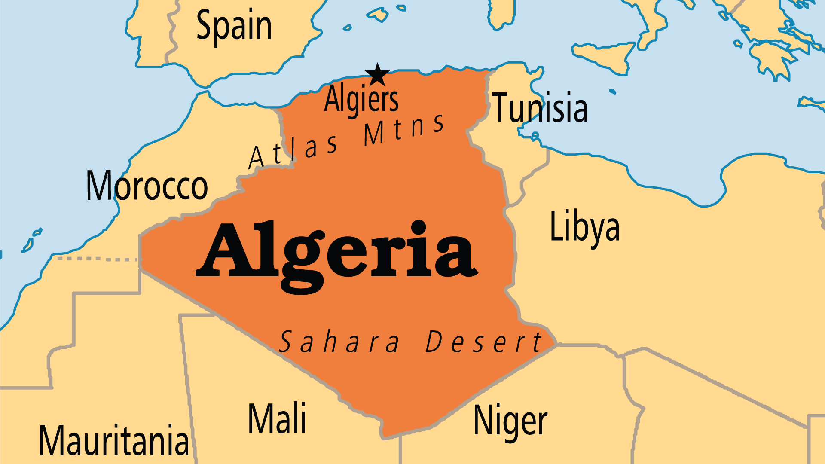
KEY STATS
Capital: | Algiers
Population: | 47,435,312
Pop Under 15 Yrs: | 31 %
Official Language: | Arabic and Berber. French and English are widely used
% Christian: | 0.3 %
Largest Religion: | Muslim
% Largest Religion: | 97.3 %
% Unevangelized: | 59 %
Persecution Ranking: | 19/50

Slide 4

FOR PRAYER
The growth of the Algerian Church over the past decade is an answer to prayer! Years of hard work by missionaries and praying people produced beautiful fruit. Most believers come from a Kabyle Berber background, but faith grows among Arabs and most other people groups as well. The Christian community's spirit of unity stands out from the long history of conflict among ethnic groups. Some received supernatural visions of Jesus, but most came to Him through personal evangelism. New fellowships began partly because Berber believers moved into unreached Arab areas with the Gospel.
Want to know more? Go to www.operationworld.org

Slide 5
FOR PRAYER
The Church has a truly Algerian way of expressing faith. Scriptures, study materials, worship styles, and even training and leadership reflect Algerian culture. Algeria needs more workers to help strengthen the local church and to bring the gospel to the unreached millions. Algerians can be reached through radio, literature, satellite TV, portable media, and Bible correspondence courses. Praise God for these resources and pray for wider distribution! As of 2025, the pressure on churches keeps increasing, so it is very important to have Christian resources in languages and formats accessible for the persecuted church to continue to grow.

