Slide 1




Slide 2

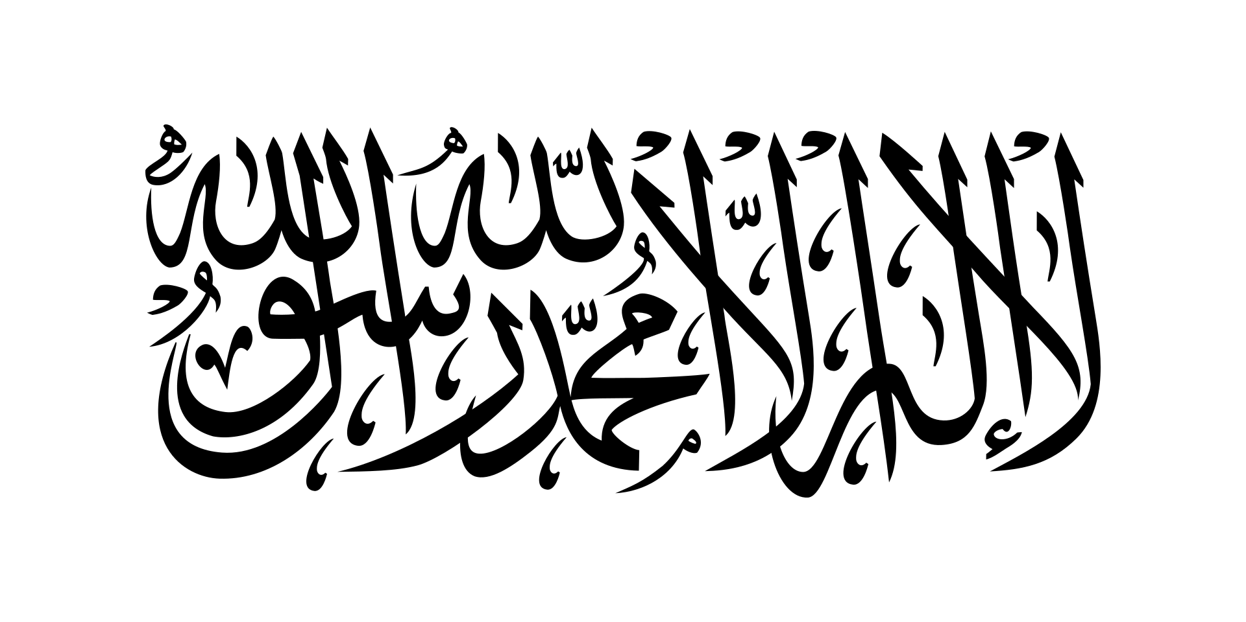
PRAYING FOR
AFGHANISTAN
Turkey
Turkey

Slide 3
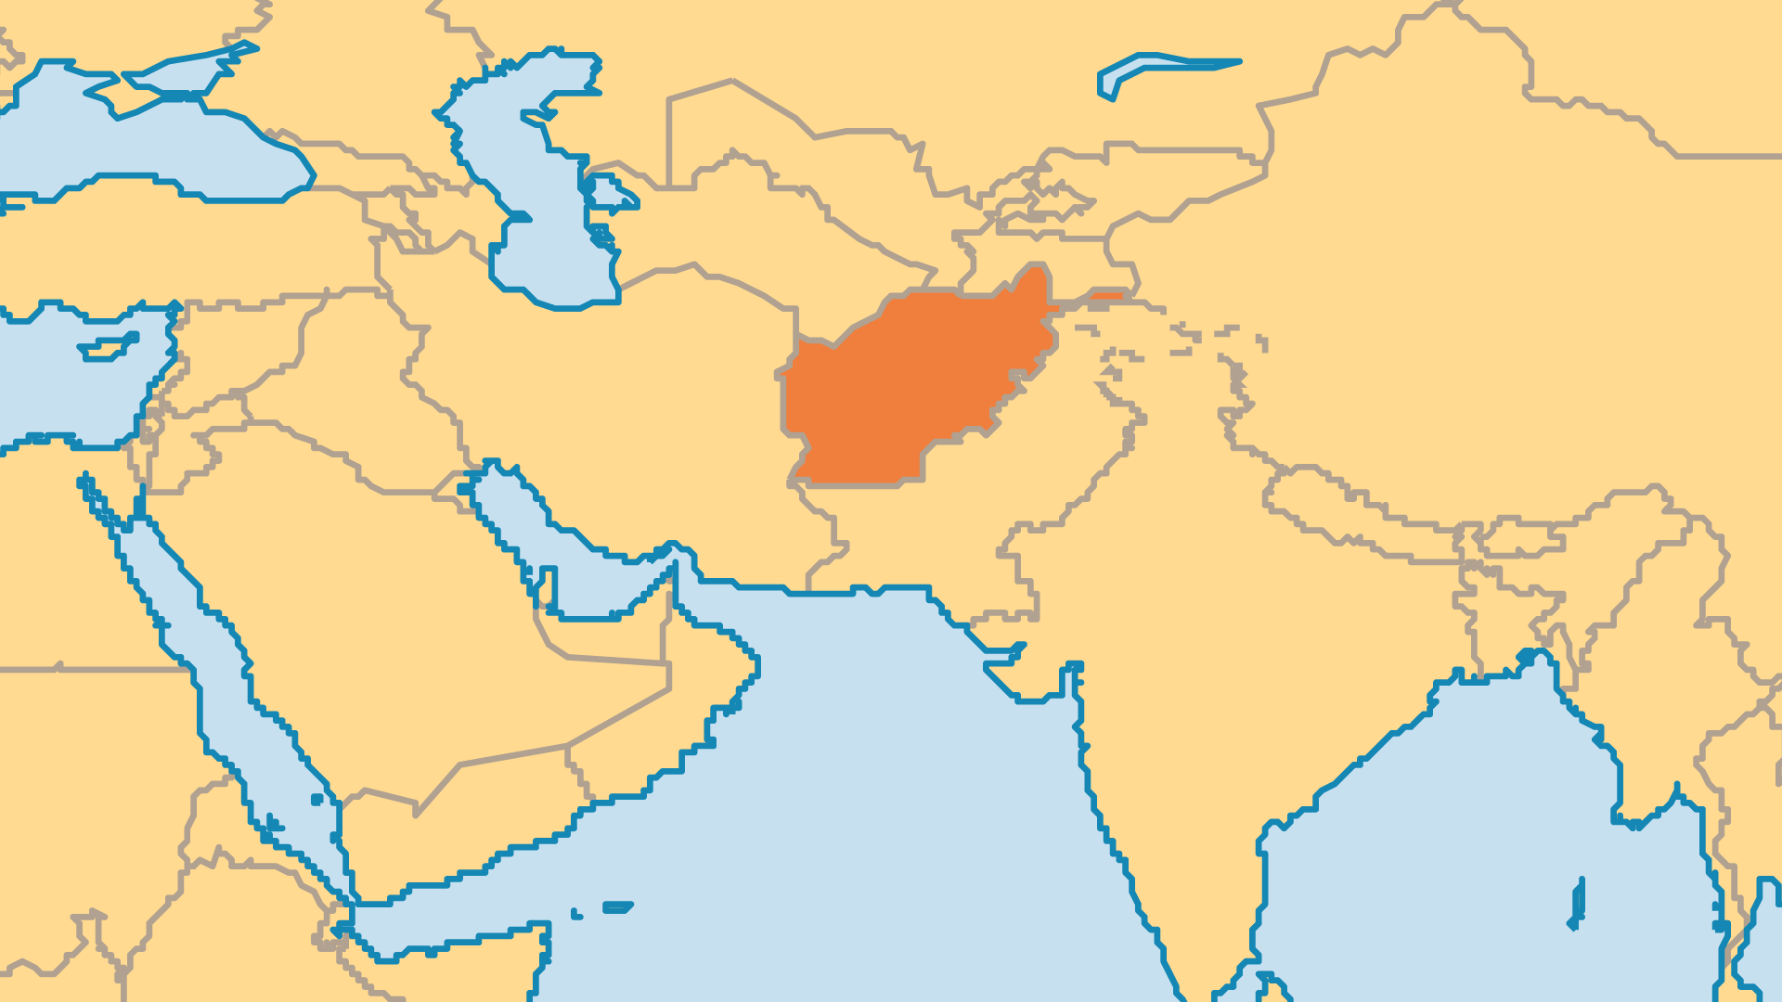
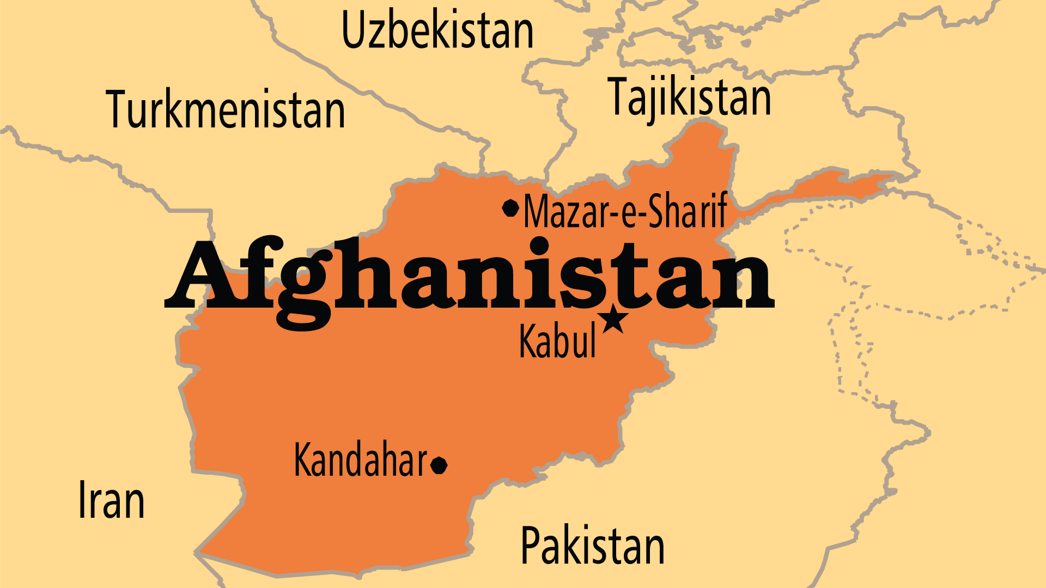
KEY STATS
Capital: | Kabul
Population: | 43,844,112
Official Language: | Pashtu (used by 48%), Dari (Afghan Persian, used by 77%)
HDI Ranking: | 180/193
% Christian: | 0.1 %
Largest Religion: | Muslim
% Unevangelized: | 81 %
Persecution Ranking: | 10/50

Slide 4

FOR PRAYER
The re-conquest of Afghanistan by the Taliban in 2021 came as a shock to many. These events led to the suspension of humanitarian aid, the reintroduction of much harsher Islamic laws, the flight of millions of Afghans from Taliban rule, the intensified persecution (and even manhunt) of Christians, and the emboldening of Islamist movements elsewhere against what they perceive as a weak and failing Western world. The aftermath of the 2023 earthquake, the gripping poverty and hunger, and current economy crisis also intensify the suffering. There is so much to pray for; cry out that God may preserve the lives of Afghans so that they might hear the good news of Jesus.

Slide 5
FOR PRAYER
The status of women deserves special prayer. Women are all but banned from participating in public life. Numerous women die in childbirth in Afghanistan because many cannot receive healthcare from male doctors. Women's voices are forbidden to be heard in public, and they cannot travel without a male guardian present. One-third of women suffer from physical violence. Widows face very difficult circumstances, and suicide is common. Special radio programmes share with women from the Bible, about the love and value God holds for them. Pray for justice and freedom from gender-based oppression, and especially that women might find the true freedom that comes only through Christ.

